Slide 1
This presentation is provided by the Monterey County Fire Training Officers Association. It intended for use by Monterey County public safety personnel or agencies, (law enforcement, fire service, EMS, dispatch, and other responders) that may be called upon to respond to, and operate at, an Active Shooter Incident. This presentation is taken directly from the Monterey County Operational Area – Active Shooter Guideline, February 3, 2015. The Active Shooter Guideline should be used as a supporting document to this presentation. The guideline is contained in the Monterey County Fire Chiefs Association, Fire Operations Manual, Volume 1, Section 5.

Slide 2
Monterey County Operational Area
Active Shooter Guideline – February 3, 2015

Slide 3
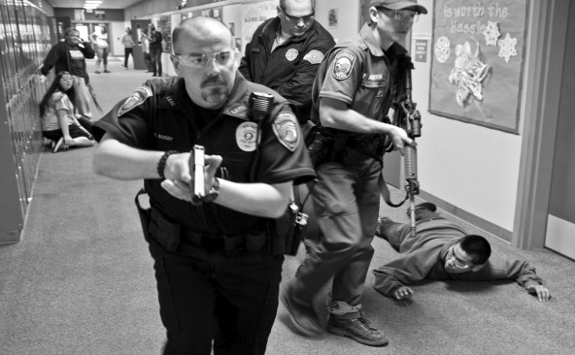
1. Purpose
This procedure establishes guidelines for Monterey County Public Safety Personnel who respond to Active Shooter Incidents (ASI). The goal is to provide effective rescue and treatment procedures, common communications, and coordination, as well as provide for responder safety while working at an Active Shooter Incident.
Recommendations for effective operations with Law Enforcement, Fire, and EMS personnel require common terminology, communications and capabilities. The purpose of operations across the responding entities is to maximize survivability for victims and is based on actions contained in the acronym THREAT: (Threat Suppression, Hemorrhage Control, Rapid Extrication, Assessment by Medical, Transport to care)

Slide 4
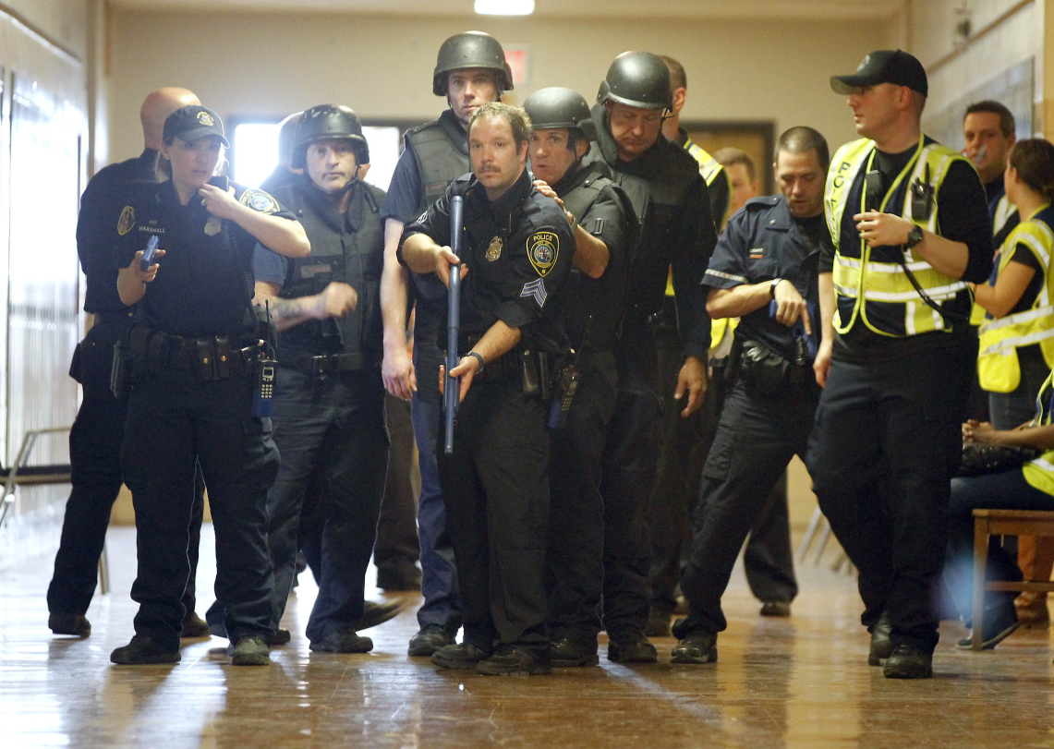
2. Use
This guideline applies to Public Safety personnel operating at the scene of an Active Shooter Emergency.

Slide 5
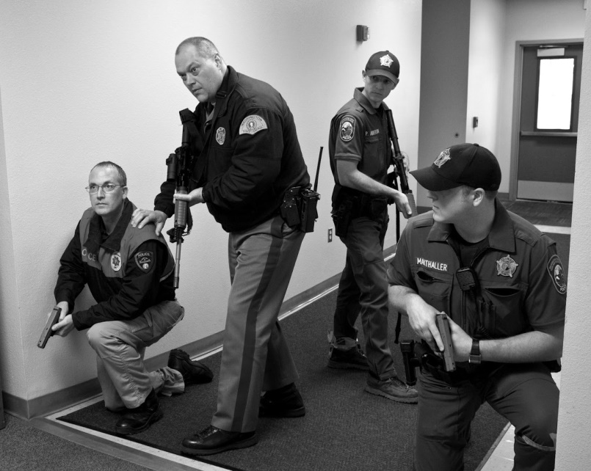
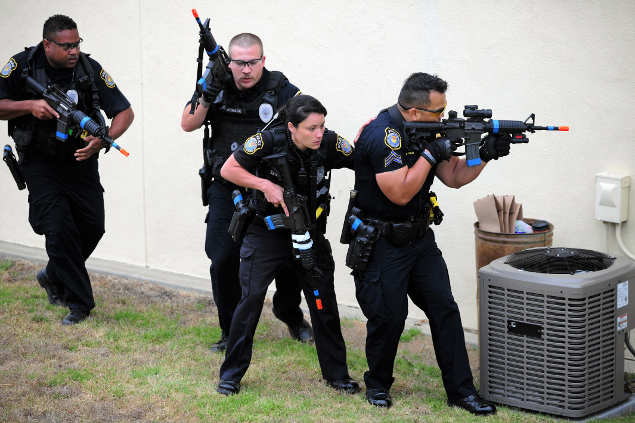
3. Procedure
a. Law Enforcement:
Law Enforcement (LE) will arrive
and make the determination that
the incident involves an active
shooter or other ongoing acts of violence.
The first responding patrol officers will form a Contact Team (CT) and proceed to locate and isolate the suspect(s) followed by additional CT’s. The role of the Contact Team (CT) is to engage the suspect(s) to limit the possibility of injury or death to victims.
As additional officers arrive, a safe perimeter will be established and a Casualty Collection Point (CCP) will be established.
Law Enforcement will take command of the incident (Incident Command - IC) and establish the location of the Incident’s Command Post (ICP) until a higher ranking LE Officer arrives. The ranking officer should then enter into Unified Command with the ranking Fire Officer as soon as possible

Slide 6
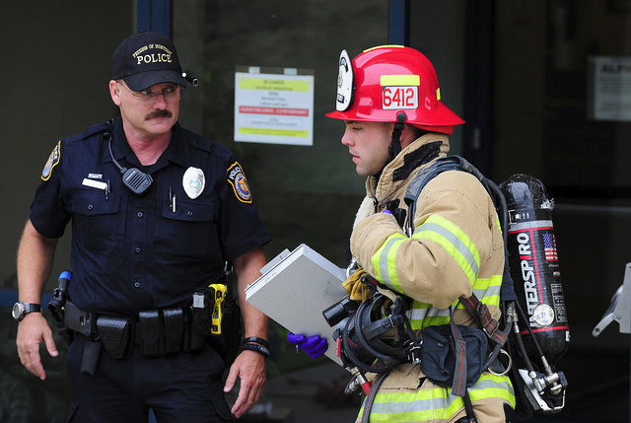
3. Procedure
b. First Arriving Fire Officer and/or Duty Chief:
The first arriving Company Officer or Duty Chief shall make contact with the on-scene Law Enforcement Incident Commander, enter into a Unified Command, determine what additional resources are needed, and assist with the development of the Incident Action Plan (IAP) (ICS-201).
The Company Officer or Duty Chief
shall also advise responding fire units
of the designated incident staging
location(s) and then provide a
face-to-face briefing to fire resources,
if possible.

Slide 7
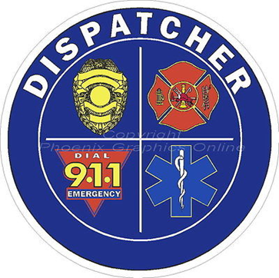
3. Procedure
c. The Emergency Communications Center :
The Emergency Communications Center Call Taker will attempt to obtain critical safety information such as location, number of suspect(s), description(s), weapon(s), injured person(s), etc.
The Call Taker will remain on the line with the caller as long as it is safe to do so and updated information is available.
Call Taker will advise caller to evacuate
if it is safe to do so.
If the caller is not able to safely evacuate,
Call Taker will instruct caller to secure their
immediate area and lock or barricade doors
and windows.

Slide 8
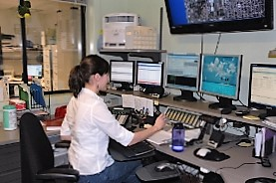
3. Procedure
d. The Law Dispatcher:
The law dispatcher will utilize the
alert tone, dispatch available units
and notify the Patrol Supervisor.
Dispatch will provide directions to the scene and will advise responding agencies if law enforcement has or are engaging the shooter.
e. The Fire Dispatcher
The fire dispatcher will dispatch the following Fire and EMS resources to an ASI event that has occurred or is occurring: 1st Alarm Assignment, 3 Ambulances and Declare a Level 1 MCI.
The Communication Center shall obtain and broadcast the following information as soon as possible: Staging location, Safe access route to command post and Updates related to the scope and size of the incident.

Slide 9
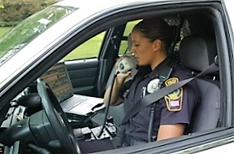
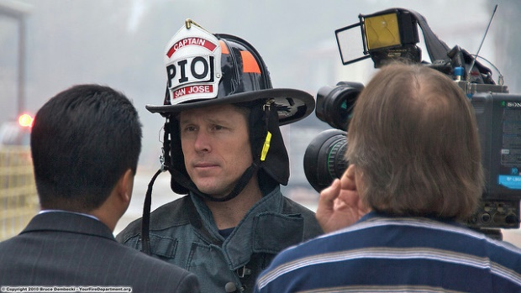
3. Procedures
f. Communications:
When practical, both a Law and Fire Branch will be established with a common command radio channel. A separate tactical radio frequency for fire, as well as for law enforcement will be used and confirmed.
Responders must use common ICS nomenclature and clear text communications.
Radio communication directly related to the police tactical operation should not be transmitted over non-encrypted channels.
g. Public Information Officer (PIO):
Consider a Public Information Officer (PIO) as soon as available due to the high public visibility of the incident.
The establishment of a Joint Information Center should also be considered to ensure consistent information is flowing from the incident.
h. OES:
The Monterey County Office of Emergency
Services can also be utilized so the County
Emergency Operations Plan (EOP) and
resources can be accessed.

Slide 10
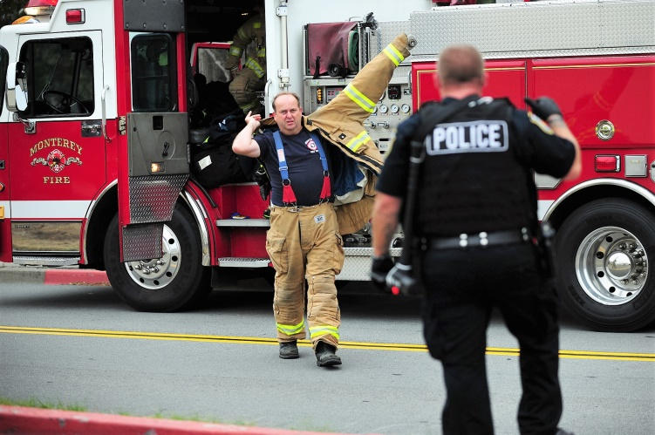
3. Procedures
i. Fire Personnel:
The ranking fire official shall
make contact with the IC.
Then a deliberate and cautious approach should be taken to the scene and, if this is known to be an ASI as initial units may not receive a “Code 4” from LE.
Fire personnel will don the appropriate Personal Protective Equipment (PPE). The minimum for fire personnel will be a ballistic vest, structure and helmet.
If possible reduce visibility risk, for example shirts with badges or PPE with reflective material.
Always maintain a high level of situational awareness.
All fire personnel must prepare to engage in a rescue group assignment.

Slide 11
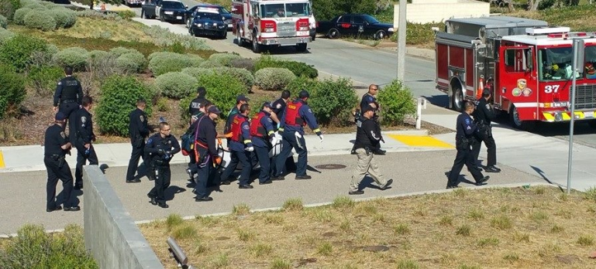
4. Deployment
a. Force Protection Group (FPG)
A Force Protection Group from Law Enforcement will escort fire companies, which should form Rescue Groups (RG) and may have a need for forcible entry and or evacuation assistance.
The Rescue Group Leader will obtain a briefing from the Force Protection Group Leader to ensure that both groups understand the objective and direction of movement. During this operation, the RG will be working for the leader of FPG.
If the Contact Team (CT) cannot move the injured to the Casualty Collection Point (CCP), then the Rescue Groups and Force Protection Groups will need to search and locate the injured victim(s) in the areas that have been cleared and deemed secured by the initial Contact Teams (CT).
The injured shall be taken to a Casualty Collection Point (CCP) by the RG’s.

Slide 12
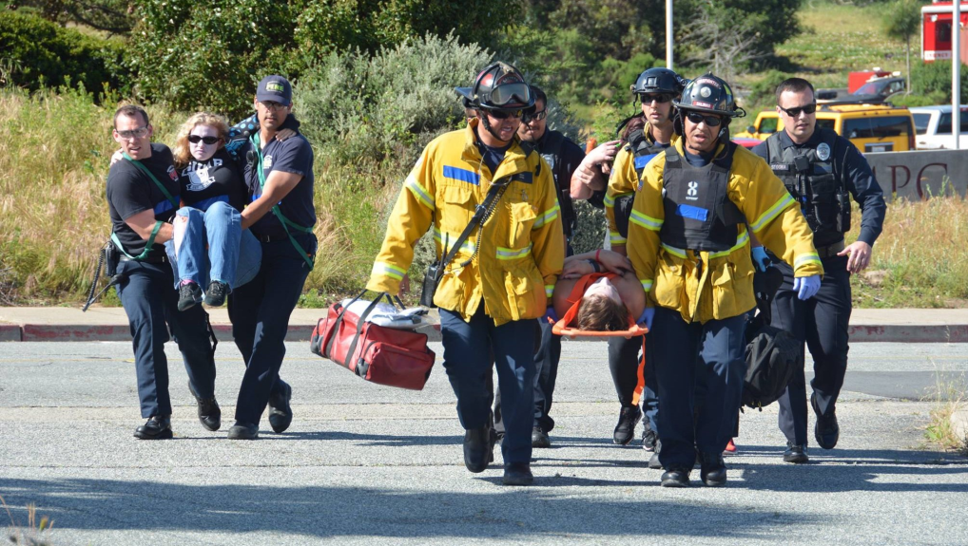
4. Deployment
b. Rescue Groups:
The goal of the Rescue Groups is
to rapidly move ASI victims with
Force Protection from the warm
zone to the Casualty Collection
Point (CCP) if needed.
If triage and or lifesaving treatment is possible it should be performed.
In injury severity priority, patients should be taken to the Treatment Area (TA) in the cold zone where more definitive medical assessment and treatment can take place.
Litter teams or available Law Enforcement personnel can move patients from the CCP to the treatment area.
The location of the CCP should be in an area where initial triage and lifesaving treatment can be safely performed. This area is often where warm and cold zones meet and should be in an area large enough to accommodate the number of expected causalities.

Slide 13
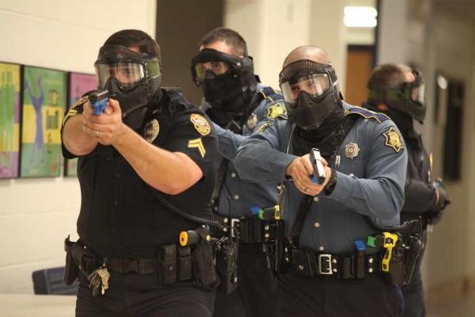
4. Deployment
c. Operating in the Warm Zone:
All personnel operating in the warm zone or CCP area must avoid hallways and doorways, and should anticipate having to bunker behind areas of cover and concealment.
RGs must maintain a high level of situational awareness and may need to relocate injured patients to a treatment area in the cold zone when safe to do so.
Consider all out of place items
dangerous and a situational
awareness for Improvised
Explosive Devices (IED)
should be maintained.

Slide 14
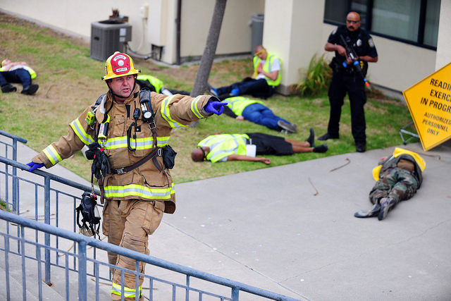
4. Deployment
d. Equipment:
Limited equipment should be
brought to the warm zone or CCP.
Recommendations for equipment in these areas are that which can be used for life saving treatment such as tourniquets, and bandages to control hemorrhage.
Additionally flashlights, thermal imaging cameras, portable forcible entry tools and triage equipment should be considered.
e. Conditions and Personnel Reports:
A recurrent CAN (Conditions, Actions, Needs) and PAR (Personnel Accountability Report) should be given to the ICP to ensure accountability and appropriate resource allocation.

Slide 15
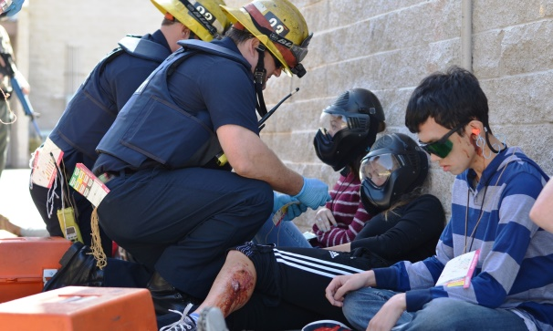
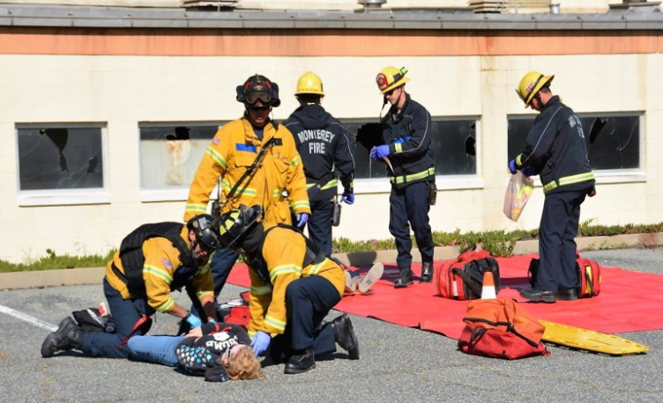
5. Patient Treatment
a. Rescue:
Once victims have been identified, located, and the area secured, the Rescue Groups with Force Protection shall proceed and perform rescues during the ongoing incident. Additional RGs shall be deployed as needed with a Force Protection Group.
b. Stabilize:
All fire personnel providing treatment in the Casualty Collection Point (CCP) should only stabilize life threatening injuries. Medical treatment should not delay the rapid movement of ASI victims to the TA.
c. CAN / PAR
A recurrent situation status or CAN
report should be given to the ICP to
ensure adequate resources are ordered
and patient number is updated. A PAR
count should also be routinely performed
to ensure accountability.

Slide 16
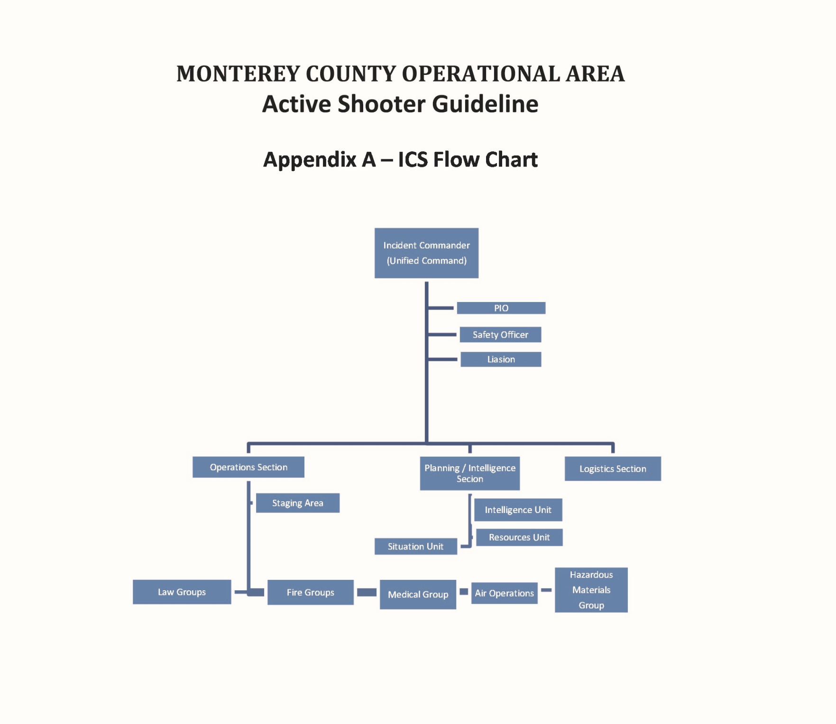

Slide 17
Appendix B – Definitions (Refer to the ASG for Definitions)
Active Shooter Incident
Active Shooter Cold Zone
Active Shooter Warm Zone
Active Shooter Hot Zone
Asymmetrical Warfare
Body Armor
Causality Collection Point
Conditions, Actions, Needs
Contact Team
Concealment
Cover
Force Protection Group
Improvised Explosive Device
Incident Action Plan
Incident Command Post
Individual First Aid Kit
Law Enforcement
Life Hazard Control Zones
Mass Casualty Incident
Personnel Accountability Report
Rescue Group
Threat
Treatment Area

Slide 18
