Slide 1
Firefighters “two-in, two-out” Regulation - April 7, 2012
OSHA Respiratory Protection Standard – 29 CFR 1910.134
Prepared by Daniel Gearhart, Division Chief, Retired

Slide 2
“Two-In, Two-Out”
In 1971, OSHA adopted a Respiratory Protection Standard requiring employers to establish and maintain a respiratory protection program for their respirator-wearing employees.
The standard, 29 CFR 1910.134, was revised in 1998 which now includes specific requirements for fire department emergency operations.
Wearing and SCBA in an IDLH atmosphere
Two firefighters work as a team during interior structure fire operations
Two firefighters be on stand-by outside the structure when firefighters are performing interior structure firefighting operations

Slide 3
“Two-In, Two-Out”
The new section of the revised regulations has been termed the Firefighters “Two-In, Two-Out” Regulation.
The revised regulations for firefighters was considered one of the most important safety advances for firefighters at the time.
The standard leaves no doubt that two-in, two-out requirements must be followed for firefighter safety and compliance with the law.

Slide 4
“Two-In, Two-Out”
The standard is found in the:
Code of Federal Regulation (29 CFR 1910.134)
California Code of Regulation (CCR, Title 8, section 5144)
The standard is also referred to in:
NFPA 1710 – Having four persons assigned to an engine company which would allow two firefighters to enter a burning structure with two still outside.
NFPA 1500 – Section 8.5.1 – 8.5.17.2
NFPA 1407: Standard for Training Fire Service Rapid Intervention Crews
FIRESCOPE – Field Operations Guide 420-1 (July 2007) Chapter 21 – Firefighter Incident Safety and Accountability Guidelines

Slide 5
“Two-In, Two-Out”
Once firefighters begin an interior attack on a structure fire, two-in, two-out provisions apply.
Per OSHA – interior structure firefighting is “the physical activity of fire suppression, rescue, or both inside buildings or enclosed structures which are involved in a fire situation beyond the incipient stage.”
Per OSHA – an incipient stage fire is a “fire which is in the initial or beginning stage and which can be controlled or extinguished by portable fire extinguishers, Class II standpipe, or small hose systems without the need for protective clothing or breathing apparatus.

Slide 6
“Two-In, Two-Out”
All firefighters engaged in interior structure firefighting must wear SCBA’s.
Wearing an SCBA means the face piece is on and the SCBA is supplying air.
Interior firefighters must work in teams of at least two.
Voice and visual contact must be maintained between the interior crew at all times while inside the structure.
Due to the potential for mechanical or reception failure, radio contact between the interior “buddy system” is not acceptable for replacing the visual or voice contact requirement.
Radios can, and should be used for communications between the interior crews and the exterior firefighters.

Slide 7
“Two-In, Two-Out”
Prior to beginning interior firefighting operations, two firefighters must be in position outside the structure at the entry point (I-RIC)
At least one firefighter outside the structure must perform accountability functions and be immediately available for firefighter rescue.
The other stand-by firefighter can perform other tasks as long those tasks do not interfere with accountability functions and can be abandoned to perform firefighter rescue.

Slide 8
“Tw0-In, Two-Out”
The regulations do not require a “two-out” team (I-RIC) for each two-person interior firefighting team. Several two-person teams or crews may be in the interior with a single rescue team outside.
Additional “two-out” stand-by teams must be added if:
The incident escalates
Accountability cannot be maintained
Rapid rescue becomes infeasible
If these conditions occur, a dedicated Rapid Intervention Crew (RIC) must replace the Initial Rapid Intervention Crew (I-RIC)
Prior to any deployment of the I-RIC or RIC to rescue firefighters in an IDLH atmosphere, the Incident Commander must be notified.
The IC must make provisions for supporting the rescue operation including notifying on-scene personnel and in-coming units.

Slide 9
“Two-In, Two-Out”
There are two exceptions to the “Two-In, Two-Out” Regulation:
An interior fire in the incipient stage.
If initial attack personnel find a known life-hazard situation where immediate action could prevent the loss of life.
Deviations from the regulation in this situation must be the exception and not the rule.
The exception is for known rescues only, not for standard search and rescue activities.
Any such actions taken in accordance with this exception provision should be thoroughly investigated by the fire department with a written report submitted to the Fire Chief.

Slide 10
“Two-In, Two-Out”
Per OSHA regulations, fire departments must develop and implement standard operating procedures addressing fire ground operations and the two-in / two-out procedures to demonstrate compliance.
Fire department training programs must ensure that firefighters understand and implement appropriate two-in / two-out procedures. [29 CFR 1910.134(c)]

Slide 11
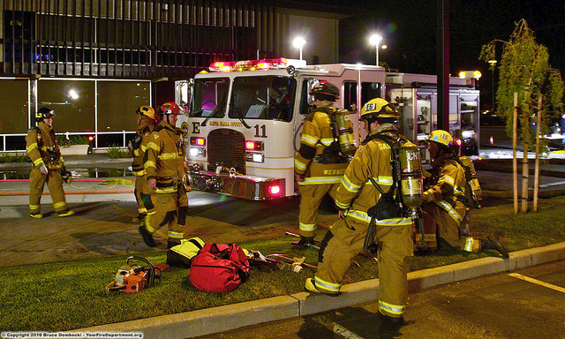
“Tw0-In, Two Out”

