Slide 1
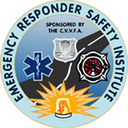
Highway Safety for Emergency Services
The “Ten Cones of Highway Incident Safety”
Provided by the Emergency Responder Safety Institute and Produced by the Volunteer Firefighter Insurance Service
Presentation compiled by:
Daniel Gearhart, Division Chief

Slide 2
This presentation relates directly to the video “Highway Safety for Emergency Services – the Ten Cones of Highway Incident Safety,” and should be used to support the material presented in the video.

Slide 3
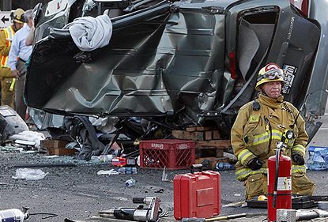
Highway Incident Safety
Firefighters respond to traffic collisions all the time.
They are all very familiar but it doesn’t always have a happy ending.
Every year highway incidents set the stage for a secondary incident, an incident where an emergency responder is struck by a motorist and is injured or killed.

Slide 4
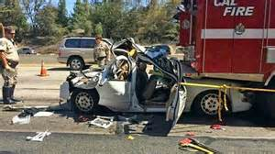
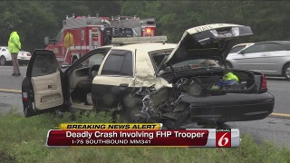
Highway Incident Safety
Each year approximately 5 firefighters are killed while operating at a highway incident
The number for law enforcement officers killed is even greater at approximately 20 per year
Additionally, several medical responders are killed every year as well

Slide 5
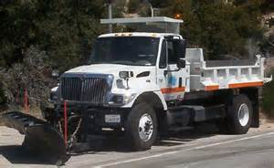
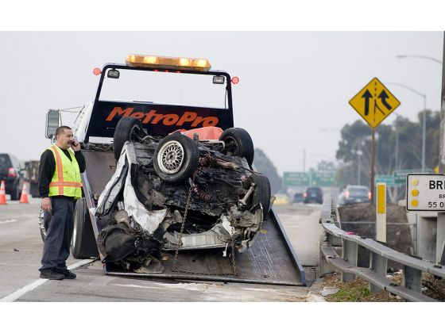
Highway Incident Safety
It’s not just firefighters, law enforcement officers, and medical personnel responding to highway incidents, other personnel may respond as well including:
Transportation Officials
Tow and Recovery Personnel
Members of the Media
Coroners
Medical Examiners
Private Contractors for
clean-up and removal
of hazardous materials

Slide 6
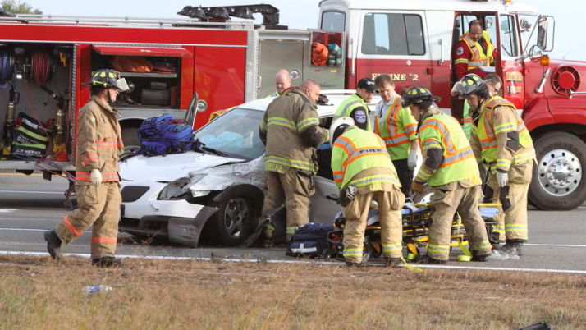
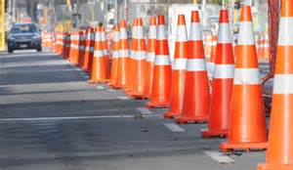
Highway Incident Safety
Secondary highway incidents pose a very real threat to everyone who responds.
What can we do about it?
Be Prepared
The following outline
of preparedness will help us be prepared .
It is the “Ten Cones of Highway Incident Safety.”

Slide 7
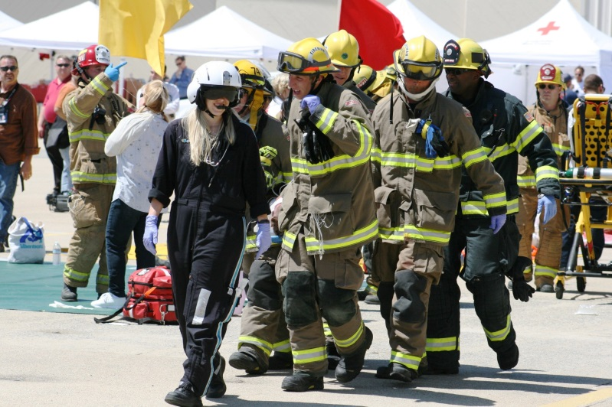
1. There is no Substitute for Training
Training is at the core of everything we do successfully.
You listen, you learn, you do.
The more you pick up from the experience, the more experienced you become.
Seek out training that
will keep you safe at a
highway traffic incident.

Slide 8
2. Multi-Agency Coordination and Communication are a Must
The incident is viewed as the orderly flow of life and traffic being disrupted.
The task of the responders is to treat the injured and restore order as quickly and safely as possible.
Orchestration and Coordination are critical.
Unified Command is essential.
Jointly developed SOP’s by all affected responders.
Once SOP’s are established, ongoing communication, review, and retirement are indispensable.
Coordination and communication are a must.

Slide 9
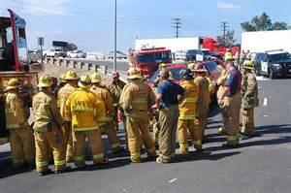
3. Limit Your Exposure… Limit Your Time
The more equipment and personnel you have responding, the more exposure to a secondary accident.
Make sure there is enough equipment and personnel, but keep it to a necessary minimum.
The risk is greater the longer you stay on-scene.
Work as quickly as prudent
and safe, and clear up the
crews as soon as possible.

Slide 10
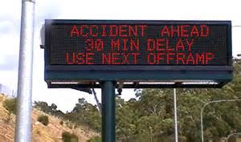
4. Give Traffic Plenty of Warning
In a perfect world, all traffic could be directed until the incident is cleared.
Managing traffic would be easy if there were no vehicles.
In the real world, delays cause stress, everybody’s in a hurry, and tempers are short.
Five years ago, the phrase “Road Rage” was never known.
Advanced warning can help.
Arrow boards, flares, cones,
police cars, detours, and
alternative routes.
Message boards have been effective to deliver real-time info.
Use whatever means available to give traffic plenty of warning.

Slide 11
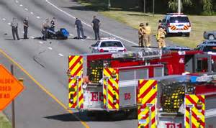
5. Protect the Scene with Apparatus
Apparatus can provide a protective shield.
It’s better to lose apparatus than lose lives.
Properly positioned, the apparatus can provide tons of fortification around the incident.
Always arrange apparatus assuming it will be struck.
Park apparatus at an angle protecting the scene with front wheels turned away from the incident.
Help create a safer zone
of response and protect
the scene with apparatus.

Slide 12
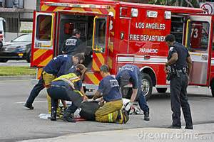
6. Always Work Away From the Traffic
Always work away from traffic.
Often the focus is on others and we forget to safeguard ourselves.
Move away from the traffic area and don’t be a target.
Watch the traffic flow before getting of your apparatus or vehicle.
You’re of no help if
you become a victim
in a secondary incident.

Slide 13
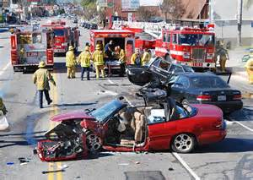
7. Be Prepared to Shut Down the Roadway
Not always popular with law enforcement or the public, but must be an option.
Closing the roadway clearly eliminates the possibility of a secondary incident.
Closing a roadway can have negative effects.
Diverting traffic to areas that may already be congested.
Taking vehicles from highways to residential areas or past schools, hospitals, etc.
Anticipate the possibilities
and be prepared to shut
down the roadway.

Slide 14
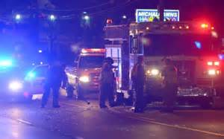
8. Be Seen and Not Hurt
The old presumption is: “The more lights the better.”
Lights can be blinding to safe drivers and a deadly attraction to those impaired by alcohol, drugs, or sleepiness.
Lights draw attention to the location apparatus but obscure the presence of emergency personnel.
Reduce the amount of emergency lights with greater emphasis on traffic control devices.
Provide illumination to the entire scene.
Use police cars as advance
warning, they tend to be
effective in slowing down traffic.

Slide 15
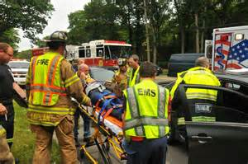
9. Dress for the Occasion
You should never be forced to choose among protective, reflective, or comfortable clothing.
If turnouts don’t provide high visibility, then get high visibility vests.
As important as getting the reflective gear, wear the reflective gear. No excuses.
Appreciate the officers
who makes you wear
them, they’re just trying
to keep you alive.

Slide 16
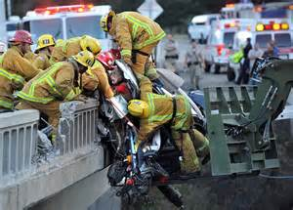
10. Accountability Matters
It’s all about responsibility.
When you take the safety of the entire organization seriously, there is a real chance that secondary incidents can be avoided.
When on the highway:
Take care of yourself
Look out for others
Keep you eyes open
Don’t do anything dangerous
Consider assigning one person as a Safety Officer to monitor every highway scene.

Slide 17
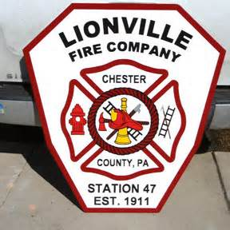
This presentation is dedicated to the members of the Lionville Fire Company and the Uwchlan Ambulance Company that were killed or injured during a secondary incident at a highway traffic collision on March 9, 1998 in Chester County, Pennsylvania. That incident was the motivation for the “Ten Cones of Highway Incident Safety” and the formation of the Emergency Responder Safety Institute. www.respondersafety.com

Slide 18
