Slide 1
OFF ROAD DRIVING

Slide 2
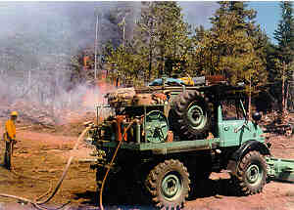
OVERVIEW
MECHANICAL SYMPATHY
CLEARANCE, WASHBOARD, MUD, ROCKS AND SAND.
APPROACH and DEPARTURE
CLIMBING HILLS

Slide 3
MECHANICAL SYMPATHY
TREAT YOUR ENGINE LIKE YOU WOULD YOUR PERSONAL VEHICLE
GET TO THE EMERGENCY AND BACK WITHOUT GETTING STUCK OR BREAKING
FINESSE YOUR WAY OVER OBSTACLES.
IF YOU GET HUNG UP ON SOMETHING, STOP, GET OUT AND FIGURE OUT WHAT IS CAUSING THE PROBLEM.

Slide 4
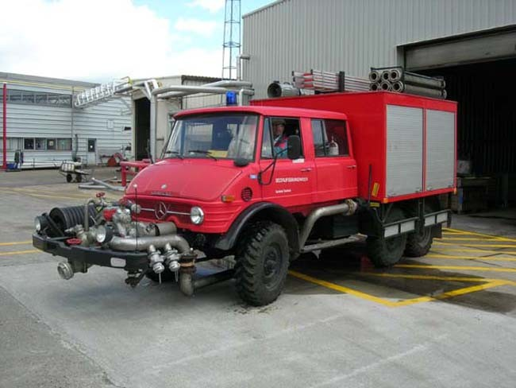
CLEARANCE
HOW MUCH CLEARANCE DO YOU HAVE UNDER YOUR VEHICLE.
USUALLY YOUR DIFFERENTIALS ARE THE LOWEST PART OF THE TRUCK.
WHAT ELSE?

Slide 5
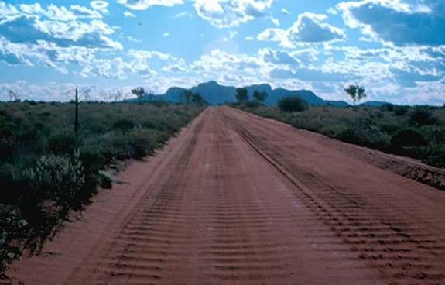
WASH BOARD
WASH BOARD CAN BE BRUTAL ON YOUR NERVES AND YOUR EQUIPMENT.
TO AVOID LOOSING CONTROL SLOW DOWN.

Slide 6
MUD
AVOID MUD WHEN POSSIBLE.
IF YOU MUST GO THROUGH THE MUD GET OUT AND LOOK
USE A STICK OR TOOL TO GAUGE HOW DEEP AND OR SOFT THE MUD IS
SUCTION FORCE NEEDED TO GET OUT OF THE MUD.
DON’T GET STUCK IN MUD!

Slide 7
ROCKS
PLAN YOUR LINE AHEAD
GO OVER THE ROCKS WITH YOUR WHEELS STRAIT
STEER BEFORE OR AFTER ROCKS
CLEARANCE, EXHAUST, DIFFENTIALS, RUNNING BOARDS (SIDE AND TAIL)

Slide 8
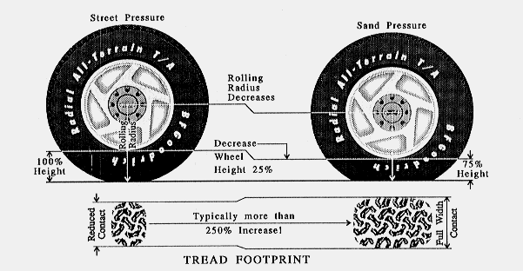
SAND
LOOSE, DRY SAND IS DIFFICULT TO STAY ON TOP OF
AIR DOWN YOUR TIRES TO FOR A BIGGER FOOT PRINT
FORWARD MOMENTUM IS KEY
CONTROL THE THROTTLE TO AVOID WHEEL SPIN
IF YOU FIND YOURSELF WITH TOTAL LACK OF FORWARD PROGRESS STOP BEFORE THE WHEELS DIG IN

Slide 9
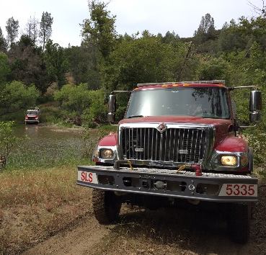
WATER
IF THE CROSSING IS UNKNOWN TO YOU, GET OUT AND CHECK THE WATER DEPTH
AS YOU EXIT WATER THE BRAKES WILL BE WET AND NOT WORK PROPERLY UNTIL THEY ARE DRY
HAVE A MECHANIC INSPECT THE VEHICLE AFTER A WATER CROSSING HIGHER THAN HALF THE HEIGHT OF YOUR TIRES
Engine water crossing
Aussie Engine

Slide 10
UNKNOWN TERRAIN
GRASS OR UNEVEN TERRAIN CAN HIDE HAZARDS.
NIGHT DRIVING
STAY ON THE TWO TRACK WHEN POSSIBLE

Slide 11
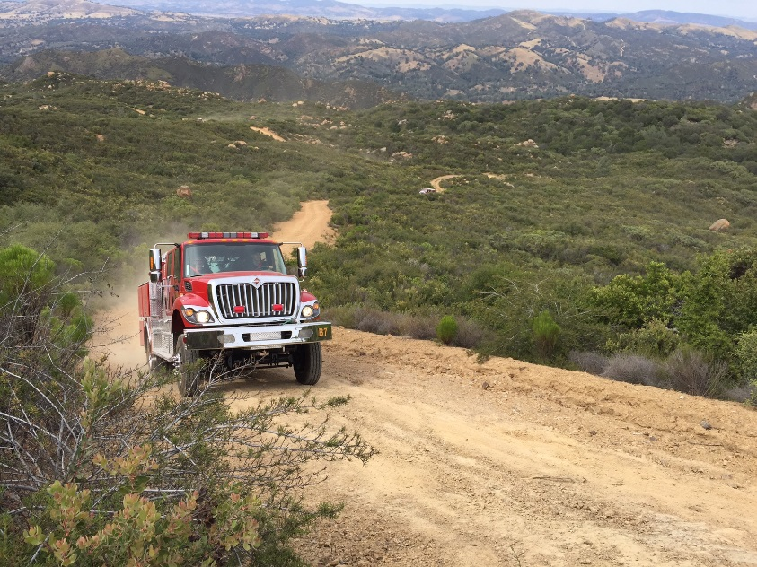
HILL CLIMB
USE LOW RANGE 4X4, CHOOSE AND STAY IN THE GEAR YOU WILL SUMMIT WITH.
STAY AT A CONSTANT RPM. LET THE VEHICLE CLIMB SLOWLY. A DOWN SHIFT AT THE WRONG TIME TAKES AWAY MOMENTUM.
IF ALL FORWARD MOMENTUM IS LOST AND WHEELS SPIN STOP!
DON’T CONTINUE TO SPIN THE WHEELS.
ASK FOR HELP
Smooth and steady

Slide 12
HILL CLIMB ABORT
SHIFT INTO REVERSE, USE THE ENGINE BRAKING
KEEP YOUR WHEELS ROLLING. THE FRONT HAS MOST OF THE WEIGHT AND BREAKING POWER.
THE FRONT END OF THE VEHICLE CAN SLIDE SIDEWAYS IF YOUR FRONT WHEELS LOCK UP.
TO STOP AND CONTINUE CLIMB SET YOUR PARKING BREAK. USE THE ACCELERATOR, WHEN YOU FEEL THE TRUCK MOVING FORWARD RELIES THE PARKING BREAK AND CONTINUE UP.
SIDEWAYS
Dakar

Slide 13
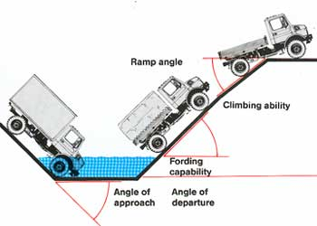
APPROACH and DEPARTURE
Approach angle is the maximum angle of a ramp onto which a vehicle can climb without interference.
Departure angle is its counterpart at the rear of the vehicle – the maximum ramp angle from which the vehicle can descend
Approach and departure angles are indicators of off-road ability of the vehicle: they indicate how steep obstacles, such as rocks or logs, the vehicle can negotiate according to its body shape alone

Slide 14
SPACING
LET THE VEHICLE IN FRONT OF YOU FINISH THEIR CLIMB.
DOES THE RIG IN FRONT HAVE ENOUGH ROOM TO BACK DOWN IF THEY NEEDED?
KEEP MOVING HOWEVER BE READY TO GO BACK IF THE NEXT ENGINE BEHIND YOU.

Slide 15
REMEMBER
WE ARE HERE TO LEARN, GAIN EXPERIENCE AND HAVE FUN.
TAKE YOUR DRIVING VERY SERIOUSLY. IT’S A LONG WAY DOWN.

Slide 16
UXO
THERE IS ALWAYS A CHANCE OF A UXO.
IT IS IMPORTANT NOT TO TOUCH IT OR GET NEAR IT.
LET YOUR INSTRUCTOR KNOW IF YOU SEE ANY UXO ON OR NEAR THE ROAD.

Slide 17
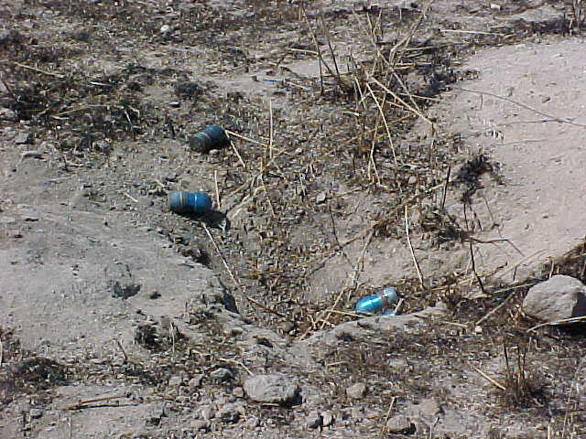
MK19 Rounds M385 40mm inert approx age 3 months
Stoney Valley TA 12

Slide 18
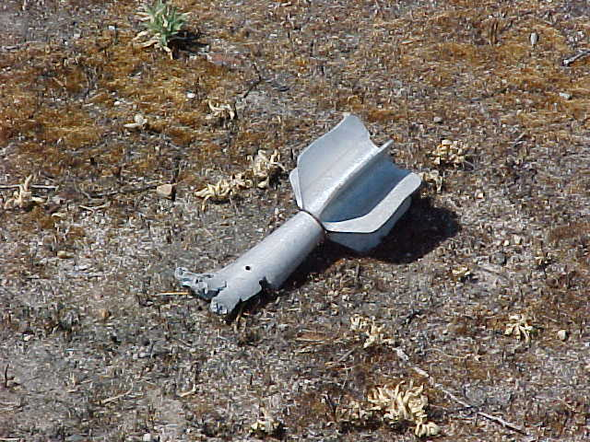
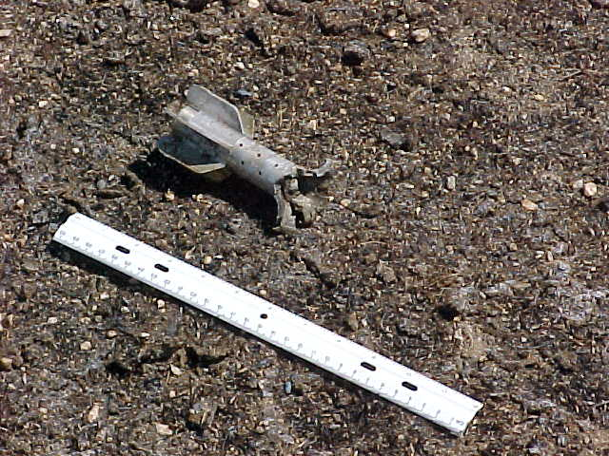
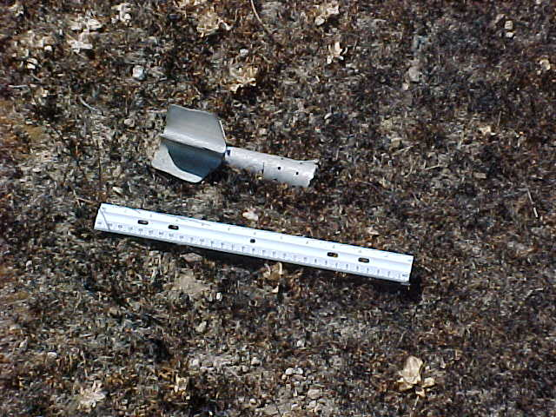
Fin 81mm HE and 60mm round approx age 2yrs +
Stoney Valley TA 12

Slide 19
ANY QUESTIONS?

