Slide 1
DMV Licensing for the Fire Service Presented By
LOS BANOS FIRE DEPARTMENT
CALIFORNIA STATE FIREFIGHTERS’ ASSOCIATION
Tim Marrison
Assistant Fire Chief
Ronny J. Coleman Former SFM
CSFA Vol. Committee Chairman

Slide 2
OPTIONS AVAILABLE FOR FIREFIGHTER LICENSING
Utilizing a DMV Commercial Testing Field Office.
Utilize the DMV ETP Program
Follow the guidelines as set forth in
AB-1648

Slide 3
Employer Testing Program (ETP) Issues within the Fire Service
Frequent changes to already approved testing routes by ETP auditors.
Mandatory re-test of a percentage of drivers
Lack of available evaluator training.
Conduct a minimum of 10 drive tests per Department examiner.
Significant changes to record keeping requirements
Etc.

Slide 4
What did AB 1648 accomplish? Assemblymembers Kevin Jeffries & Wes Chesbro
-PROS-
No longer subject to audit by DMV ETP auditors
Allows Departments to empower multiple evaluators within their department without ETP refresher training.
Allows Class C driver (trainee)to operate any Fire Department vehicle while accompanied by a Class B Department authorized trainer
Allows Departments to develop drive routes specific to their jurisdiction based on NFPA 1002 Chapter 4 (2008)
Allows State Fire Marshal Driver Operator 1A to be recognized as training requirements

Slide 5
What did AB 1648 accomplish? Assemblymembers Kevin Jeffries & Wes Chesbro
CONS
Requires Department authorized trainer to maintain a Commercial Class A or B license
Requires a Non-commercial Class C (FF endorsement) to obtain a Physician’s Health Report (DL546A) every
4 years.
Estimated cost $70.00

Slide 6
What did AB 82 accomplish?
AB 82 clarifies that those who already have, or intend to get, a full commercial class A or B license do not need to obtain a firefighter endorsement (unless required by the fire department).
The DMV will recognize these drivers are already trained to operate the heavy equipment.
This bill will keep intact the firefighter endorsement option for those with a regular class C, restricted class A or noncommercial class B license; since these licenses will need an additional employer certification and testing to ensure the quality of our firefighter equipment operators.
AB 82 made no other changes to the process put in place by AB 1648.

Slide 7
Why would you want a Firefighter Endorsement on a Commercial Class B License if it is no longer required?
The Firefighter Endorsement allows any Class of license to operate Class A
“Fire Department equipment”
-Including Tiller-
A Commercial Class “B” without Endorsement does not.

Slide 8
Our Goal For Today is To walk you through the following procedures
What does a Class B FF restricted holder need to do now ?
Class C license adding a Firefighter Endorsement.
Class C with Firefighter Endorsement upgrading to a Commercial A/B/C
Commercial A/B/C with Firefighter Endorsement downgrading to a Non-Commercial A/B/C with Endorsement
Continued

Slide 9
Our Goal For Today is To walk you through the following procedures
Commercial Class A/B/C adding Firefighter Endorsement
Restricted Class A/B Firefighter license at time of renewal
Requirements to be a Fire Department approved driver Trainer/Evaluator
What are the two TRAINING options available to obtain a Class C Firefighter Endorsement?

Slide 10
What is required to operate firefighting equipment?
Effective January 1, 2011, California Vehicle Code Section 12804.11(a) requires an individual who operates firefighting equipment, over 26,000 GVWR, including a tiller operator, to hold a non-commercial class A, B, or C with a Firefighter Endorsement or hold a class A or B non-restricted commercial driver’s license.

Slide 11
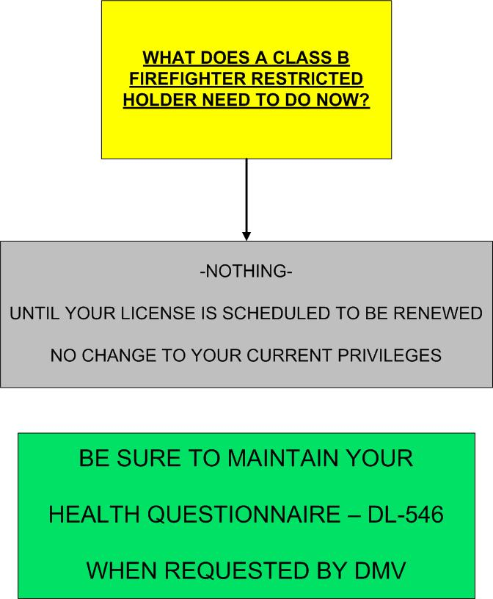

Slide 12
Current Commercial A or B Firefighter
Restricted Driver License
Your current Commercial A or B Firefighter Restricted license is valid up to the expiration date of your license. You will still be required to maintain a Health Questionnaire (DL 546) up to the expiration date on your license. After the expiration date, you will be required to send in a Physician’s Health Report (DL 546A) form signed by a physician. The 546A form is different than the Commercial DL 51 medical evaluation form. The 546A is valid for 4 years and also requires a physician signature. Once your commercial A or B Firefighter restricted has expired, you will have to determine if you want to go to a Class C driver license with a Firefighter endorsement or a Commercial Class A or B driver license. A Commercial Class A or B Restricted Firefighter driver license will no longer be valid or obtainable after the license expiration date.
DL 546 Medical questionnaires up to the license expiration date.
DL 546A after the license expiration date. Good for 4 years
Must take place at a DMV Field Office.

Slide 13
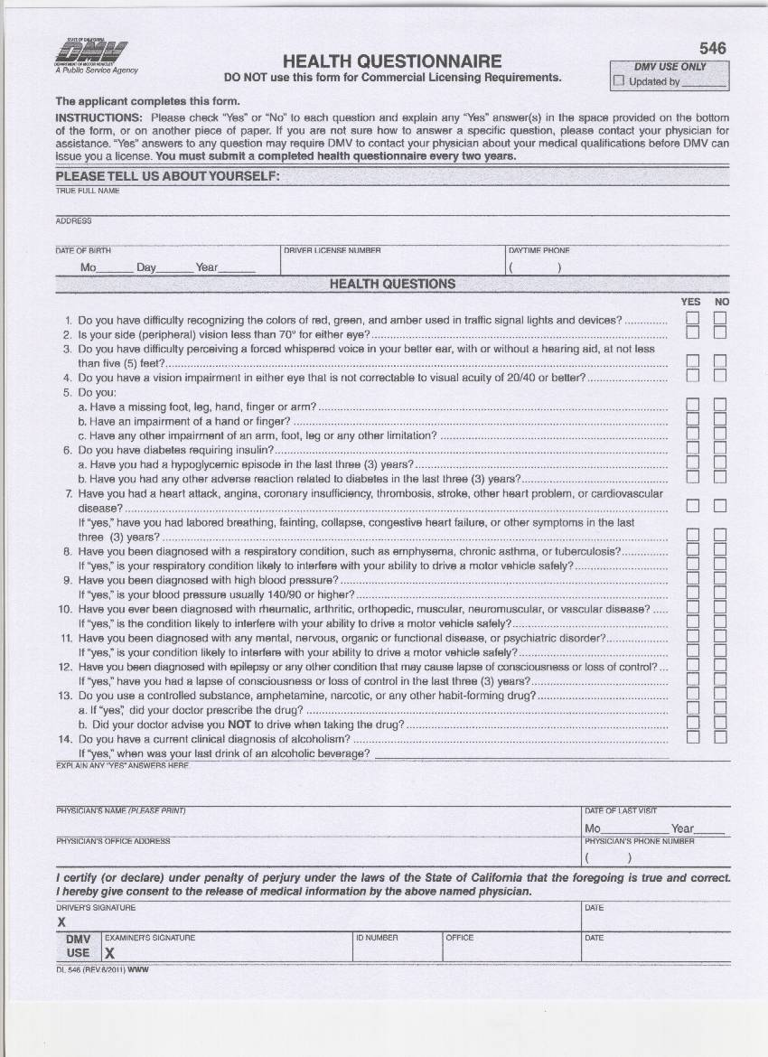
DL -546

Slide 14
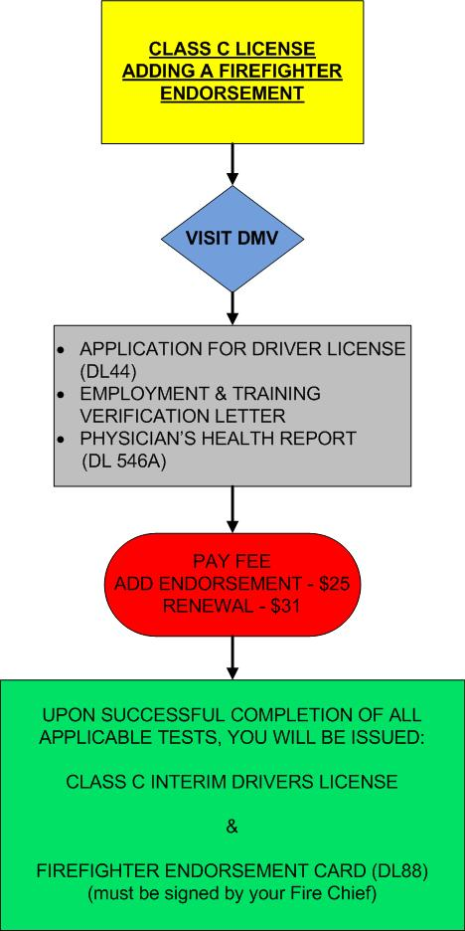

Slide 15
Obtain a Class C driver license with a Firefighter Endorsement (New Drivers)
For someone who is planning on becoming a new driver for your department and does not desire a commercial Class A or B driver license, they are required to hold a valid class C driver license and meet the following requirements:
Successfully complete Driver Operator 1A and/or meet or exceeds the standard outlined in NFPA 1002, chapter 4 (2008 version).
Verification of employment and training from the Fire Chief or Designee.
DL 546A Physician’s Health Report form signed by a physician. Valid for 4 years.
DMV Class C general knowledge written test.
DMV Firefighter Non Commercial Drivers License knowledge test.

Slide 18
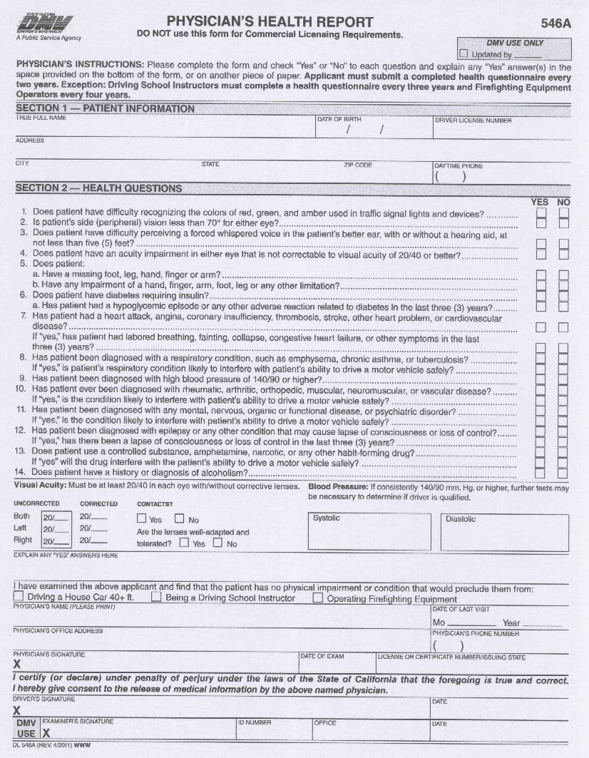
DL-546A

Slide 19
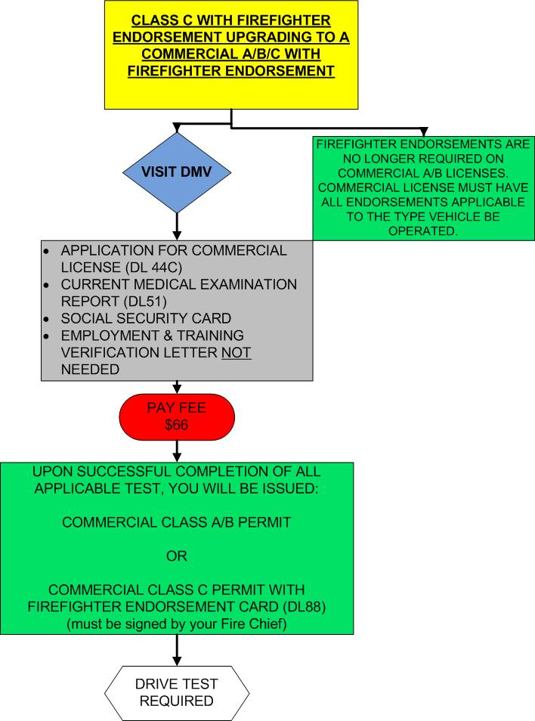

Slide 20
If your Fire Department chooses to use AB-1648 to obtain your Firefighters Licenses, your Firefighters will be issued a Non-Commercial Class C license with Firefighter Endorsement.
If the Firefighter Chooses to upgrade that License, in the future, to a Commercial Class A/B/C with Firefighter Endorsement, the following steps must be taken.
Visit your DMV Field Office and complete a Commercial License Application(DL44C)
Provide a current Medical Examination report (DL51) 2 year exam. They probably currently have a (DL546A) which is a 4 year exam.
They will need to take the Commercial written test and Firefighter Endorsement test.
They will be given a permit for the class of license they are applying for.
They will need to do a Drive Test at a DMV Commercial Testing Facility

Slide 21
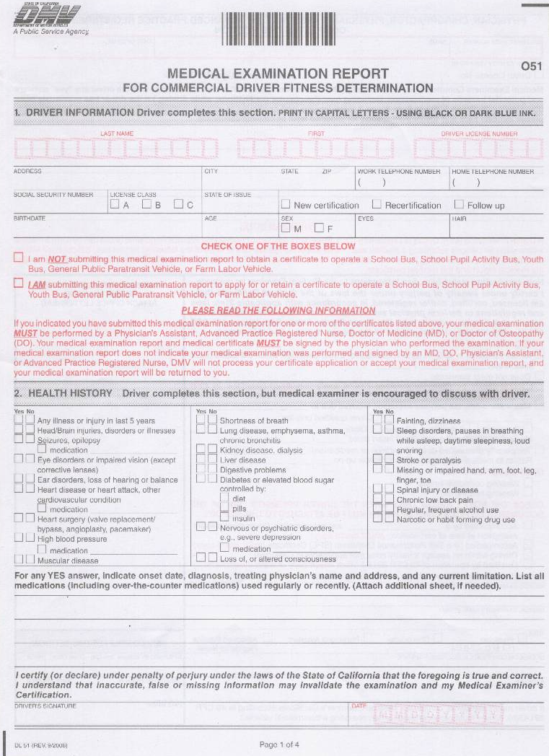
DL-51

Slide 22
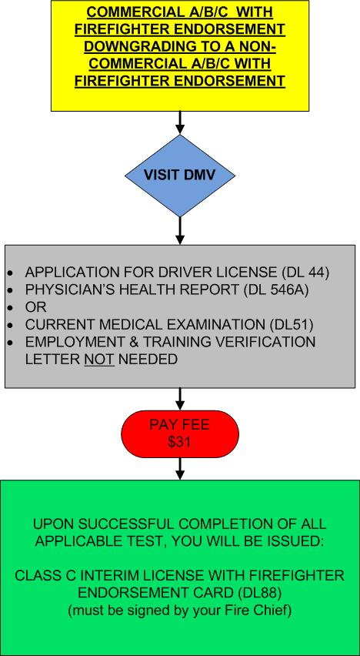

Slide 23
Your Firefighters may consider downgrading their Commercial Class A/B/C Firefighter Endorsement License to a Non-Commercial Class A/B/C with Firefighter Endorsement.
This option will eliminate that Firefighters ability to become a driver Trainer in the future. Trainers are required to have a Commercial
Class A or B License

Slide 24
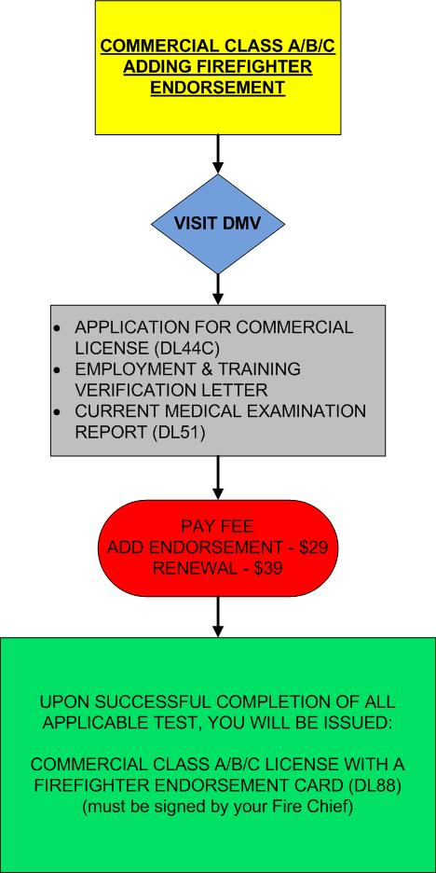

Slide 25
If your Firefighter already holds a Commercial Class A/B/C license and would like to add the Firefighter Endorsement, the following steps must be taken
Visit the field DMV office and complete a Commercial License Application (DL44C)
Take the necessary Firefighter Endorsement tests.
Submit an Employment & Training verification letter with approved signature to DMV
Assure that your Medical Examination Report is current.

Slide 26
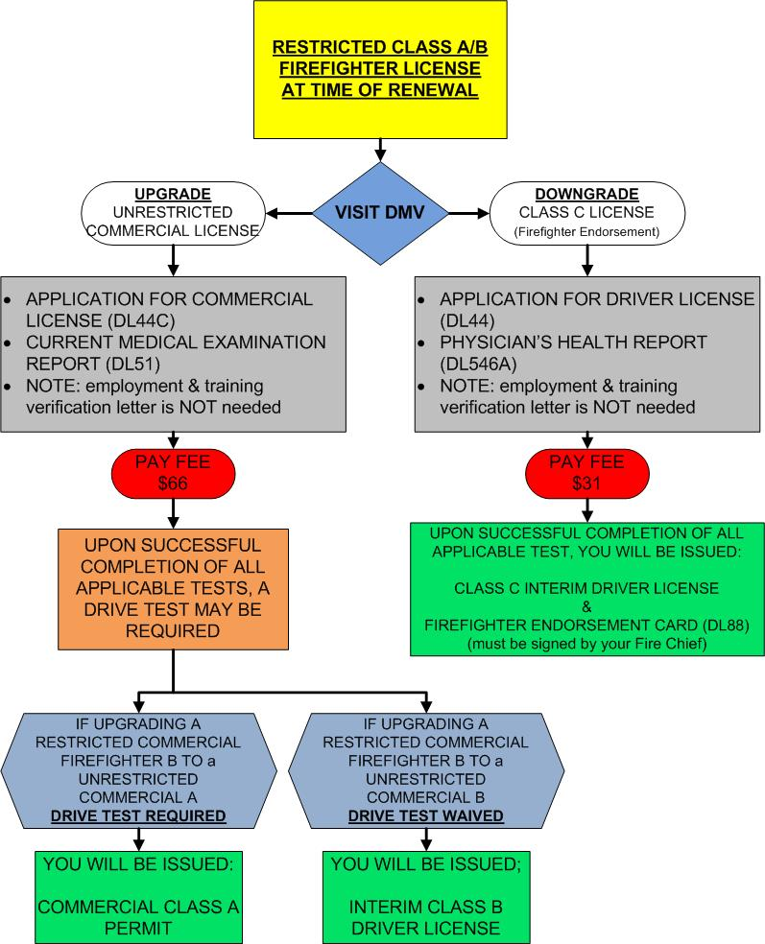

Slide 27
Current Commercial A or B Firefighter Restricted driver license holders that want to become an Unrestricted Commercial Class A or B driver license holder.
You can move from restricted driver license to an unrestricted driver license within the same class you currently possess
without having to take a new road test.
Must have a current DL 51 Medical form signed by a physician or have a current DL 51 on file with the DMV.
You must have the green card in your possession.
Required to pass the Firefighters Non Commercial Drivers License Knowledge Test and all applicable written tests.
Must take place at a DMV Field Office.
If you want to move from a Class B to a Class A unrestricted, you will be required to take a Commercial Class A road test with all the current commercial written testing requirements.

Slide 28
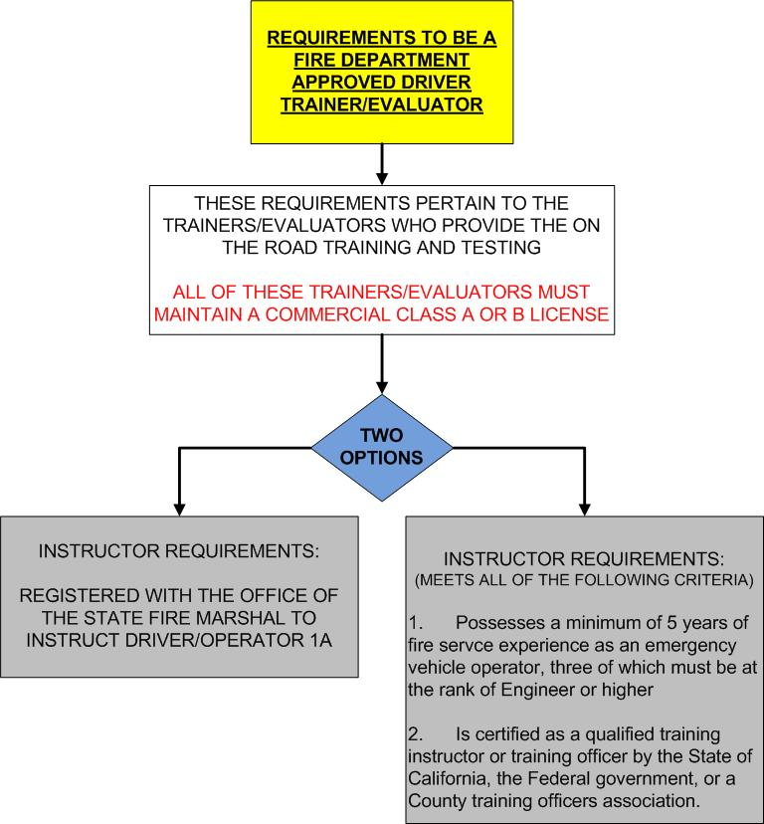

Slide 29
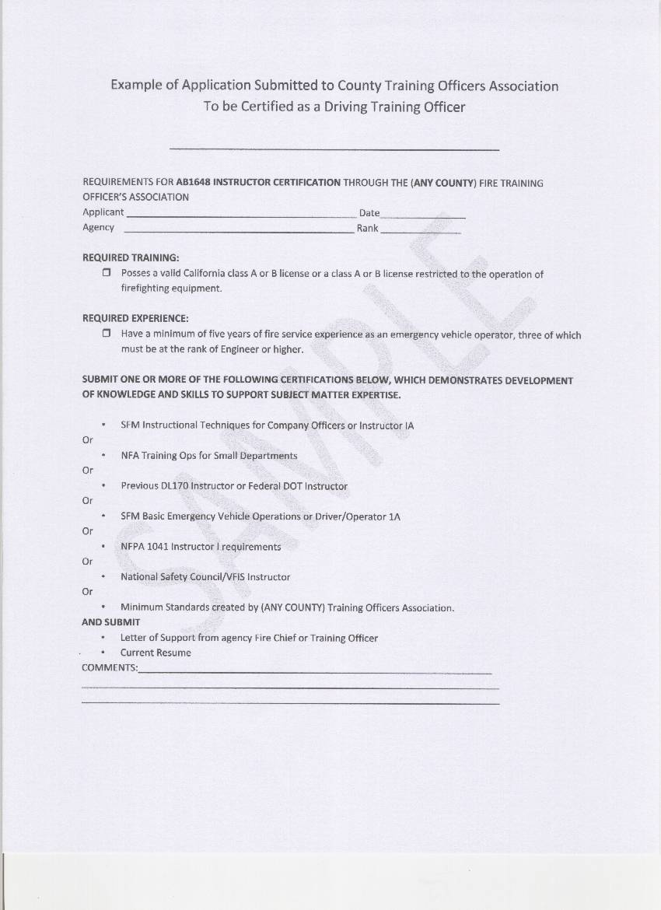

Slide 30
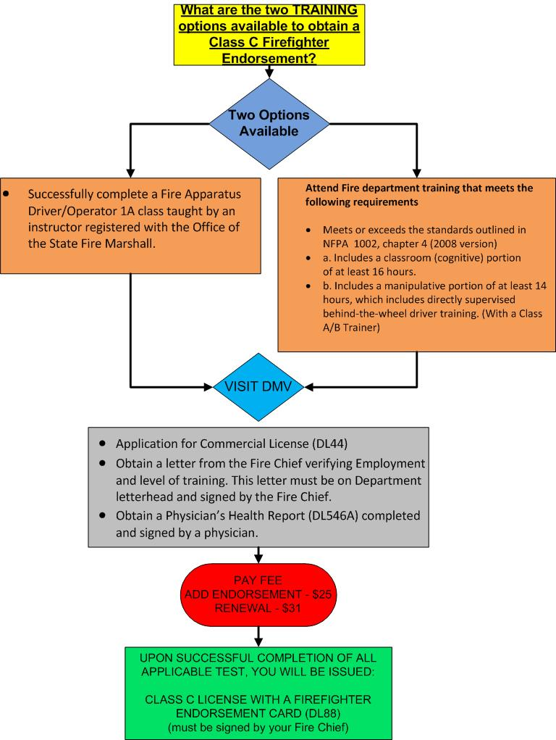

Slide 32
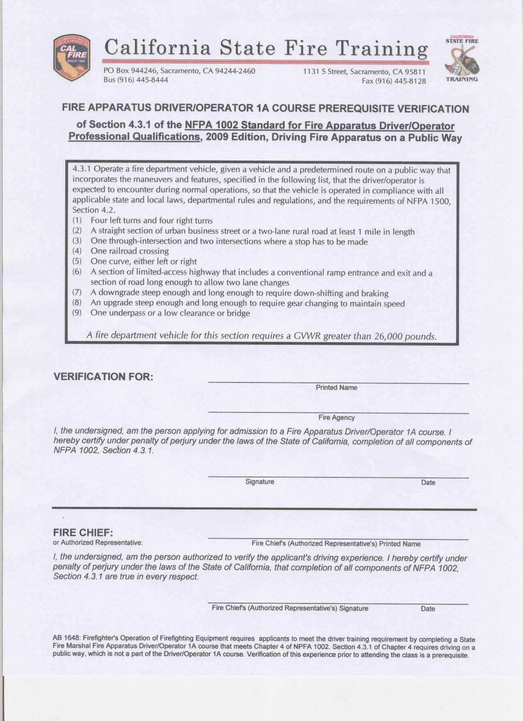

Slide 33
DMV “PULL PROGRAM”
Fire agencies are now required to participate in the DMV “Pull Program”. Cal. Veh. Code Section 1808.1 (h) (2)
Fire agencies are NOT subject to FEES to participate in Pull Program
Pull Program requires initial screening, record updates, routine review and employers to not allow drivers to operate if they have violations.

Slide 34
-Bottom Line- What do we “NEED” to do?
Maintain a Firefighter driver training program that exceeds the DMV ETP program – DON’T GET LAZY
Assure that your Departments drive route complies with NFPA 1002 Chapter 4 2008 – Use your old ETP route
Create a Verification of Employment & Training document
Develop a Certification process within your County to Certify Trainer/Evaluators –OR- maintain SFM Driver/Operator 1A Instructors
Provide DL 51 Dr. Physicals to your Commercial Class A & B drivers every 2 years
Provide DL 546A Physicals to your Non-Commercial Class C Firefighter Endorsement drivers every 4 years.

Slide 35
-Bottom Line- What do we “NEED” to do?
Schedule your Dr. Physicals a minimum of 1 month prior to Drivers license expiration.
Maintain some Commercial Class “A&B” Drivers for training & testing purposes.
Participate in DMV “PULL” Program
Provide your new drivers (in training) with a minimum of 16 hours of Classroom training & 14 hours of behind the wheel training – DOCUMENT IT-
CHANGE THE LAW SO THE DRIVER TRAINER/EVALUATOR IS NOT REQUIRED TO POSSESS A COMMERCIAL CLASS A/B LICENSE
CHANGE THE LAW SO A NON-COMMERCIAL CLASS C WITH FIREFIGHTER ENDORSEMENT ONLY REQUIRES A DL-546 MEDICAL HEALTH QUESTIONNAIRE

Slide 36
Questions
&
Answers

