Slide 2
WUI Placard

Slide 3
Purpose
The WUI Placard (ICS 231) is designed to document property information found during structure assessment. (At a specific point in time)
The WUI Placard (ICS 231) allows the firefighters to communicate a basic assessment of conditions to other responding units.

Slide 4
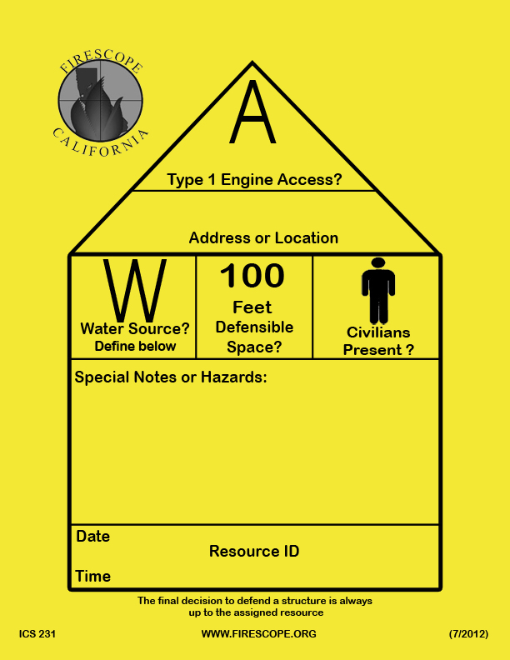
WUI Placard
8.5 X 11”
Print on yellow card stock – Preferably 60lb minimum
1” border to accommodate tape
All text and symbols are black to allow for photocopying
Print 2-sided with directions for use on back side

Slide 5
WUI Placard
Instructions for completing the placard

Slide 6
1: Access: Does it appear to have access/egress and turnarounds for Type I fire engines?
Yes = Circle
O
No = Circle with diagonal slash
Ø

Slide 7
2: Address or Location:
Complete for address or
location being assessed
Write in

Slide 8
3: Water Source: Does the structure appear to have a water source for use by fire engines? (i.e. swimming pool, hot tub, garden hose, hydrant)
Yes = Circle (describe in the “Special Notes or Hazards” area)
O
No = Circle with diagonal slash
Ø

Slide 9
4: Defensible Space: Does it appear that a minimum of 100’ of combustible vegetation has been cleared away from the structure?
Yes = Circle
O
No = Circle with diagonal slash
Ø

Slide 10
5: Civilians Present: Do civilians appear to be present at the site?
Yes = Circle (describe in the “Special Notes or Hazards” area)
O
No = Circle with diagonal slash
Ø

Slide 11
Special Notes or Hazards:
Identify any special
notes or hazards in
this area

Slide 12
6: Date and Time: Write in
7: Resource ID: Write in

Slide 13
WUI Placard
instructions
for use
On back of
placard

Slide 14
WUI Placard
Instructions for placement and posting of completed document

Slide 15
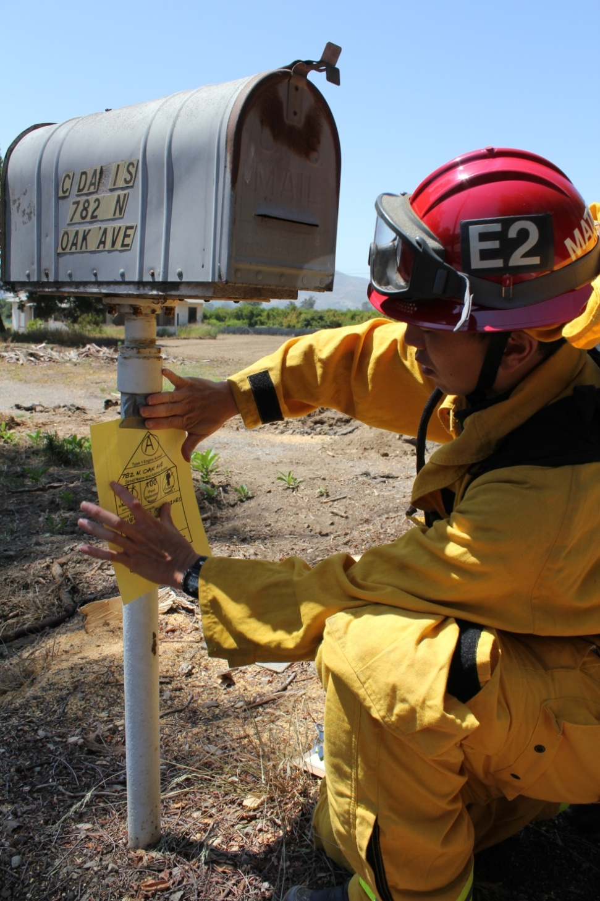
Place card in a
location visible
from the street.

Slide 16
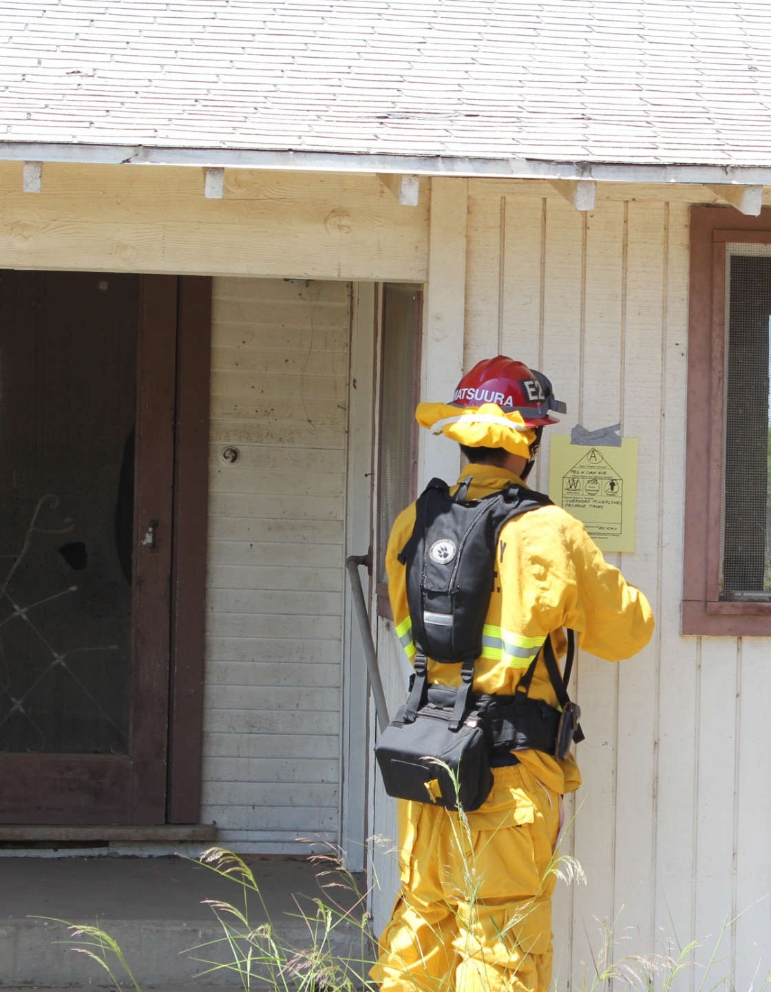
Place card in a
location visible
from the street

Slide 17
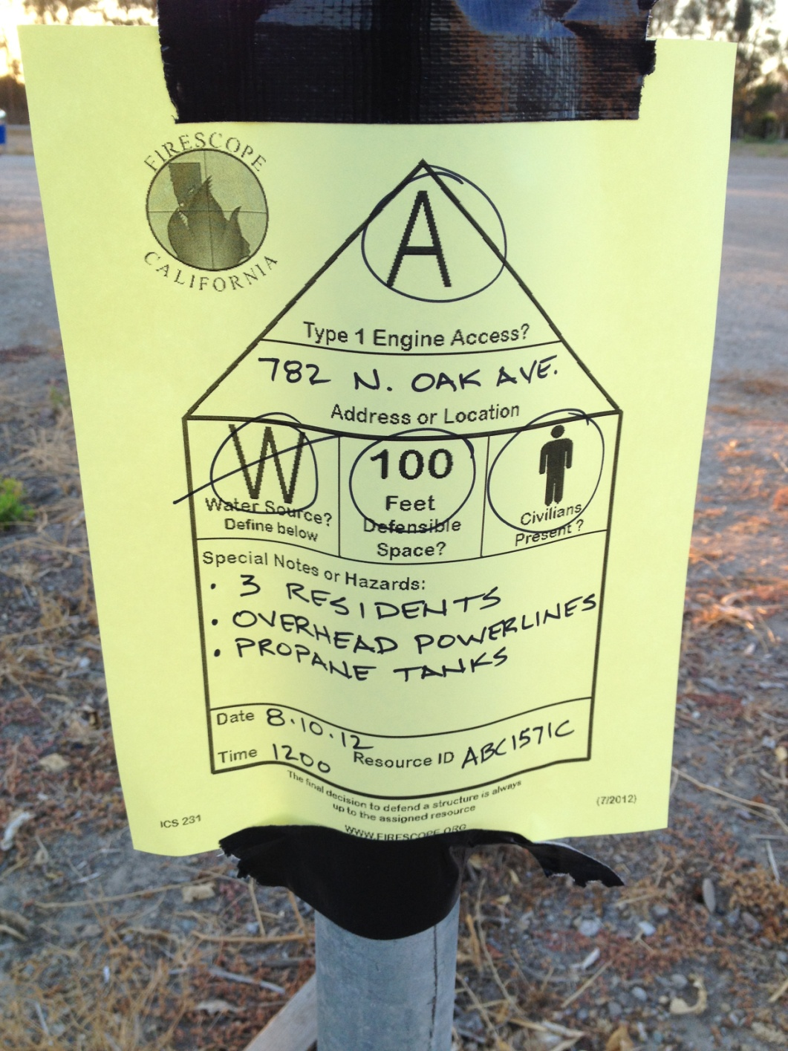
Make sure card is legible
and the information is
easy to understand

Slide 18
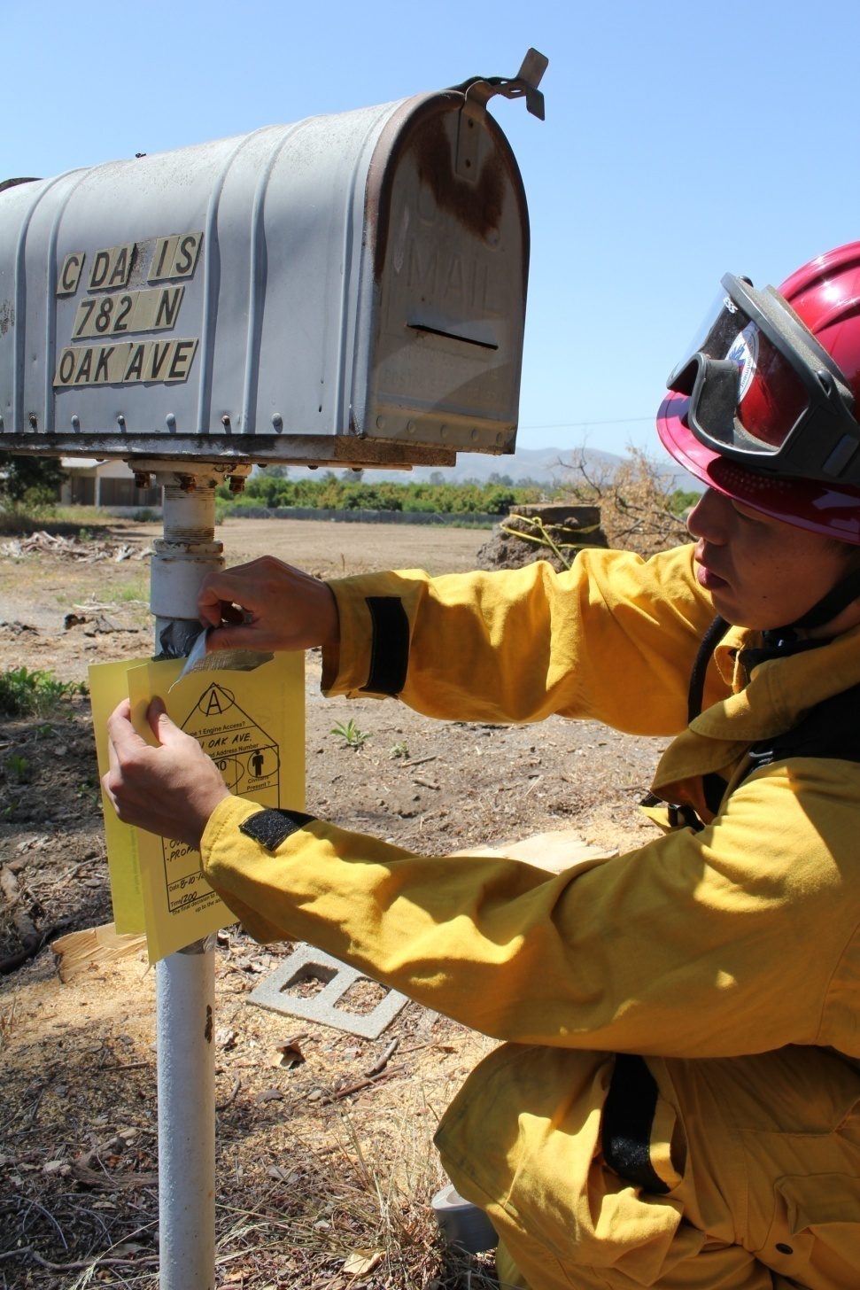
Additional WUI Placards
may be placed over previous
cards when there are
significant changes observed.
This will also give resources
a more thorough history of
the residence.

Slide 19
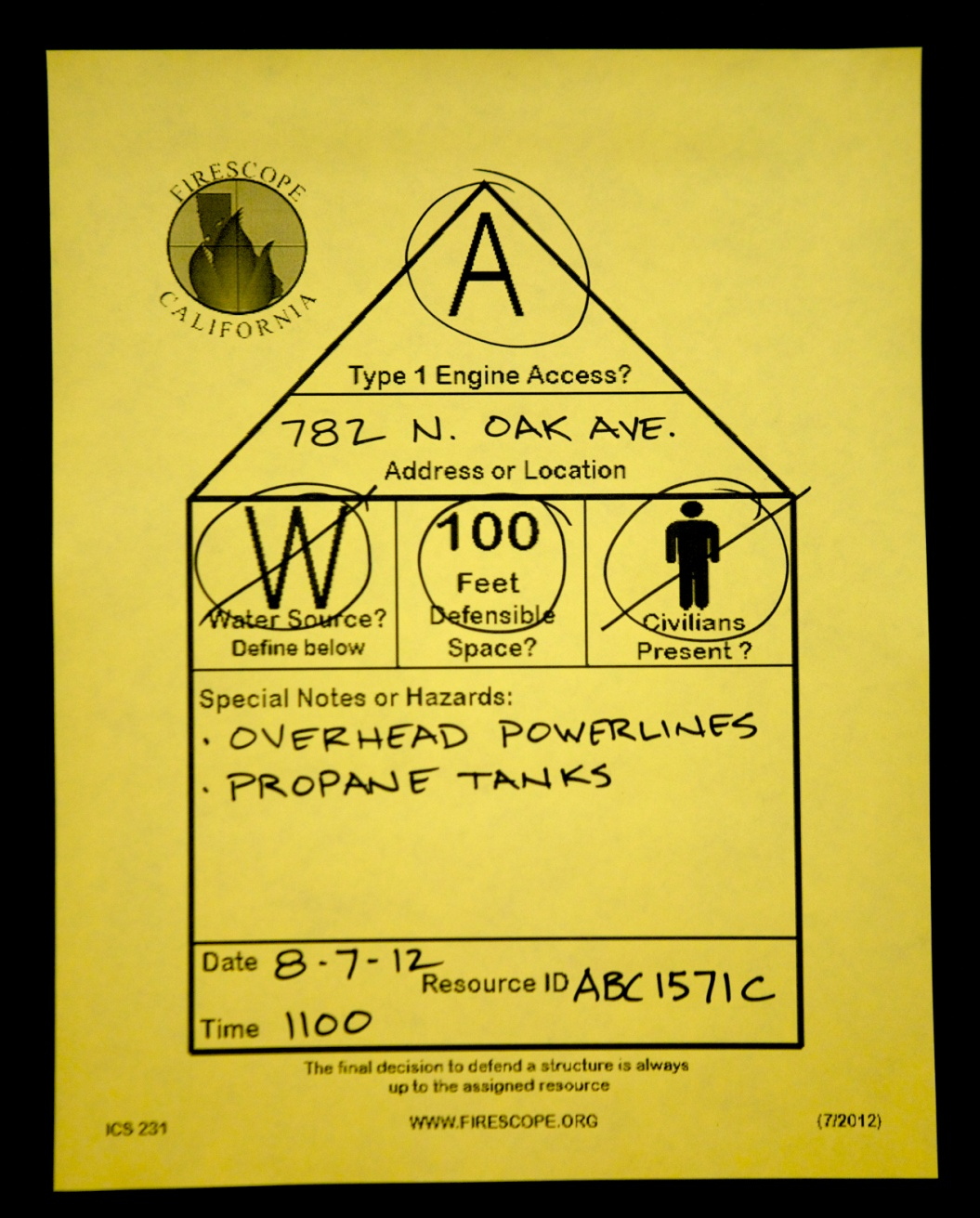
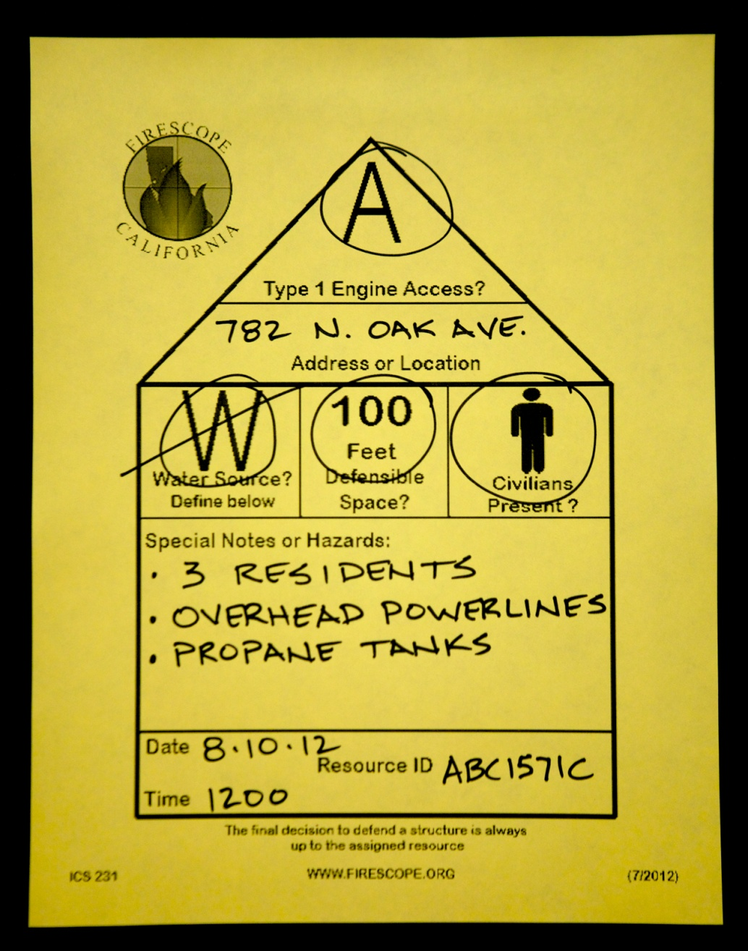
Note changes in information at different assessment times

Slide 20
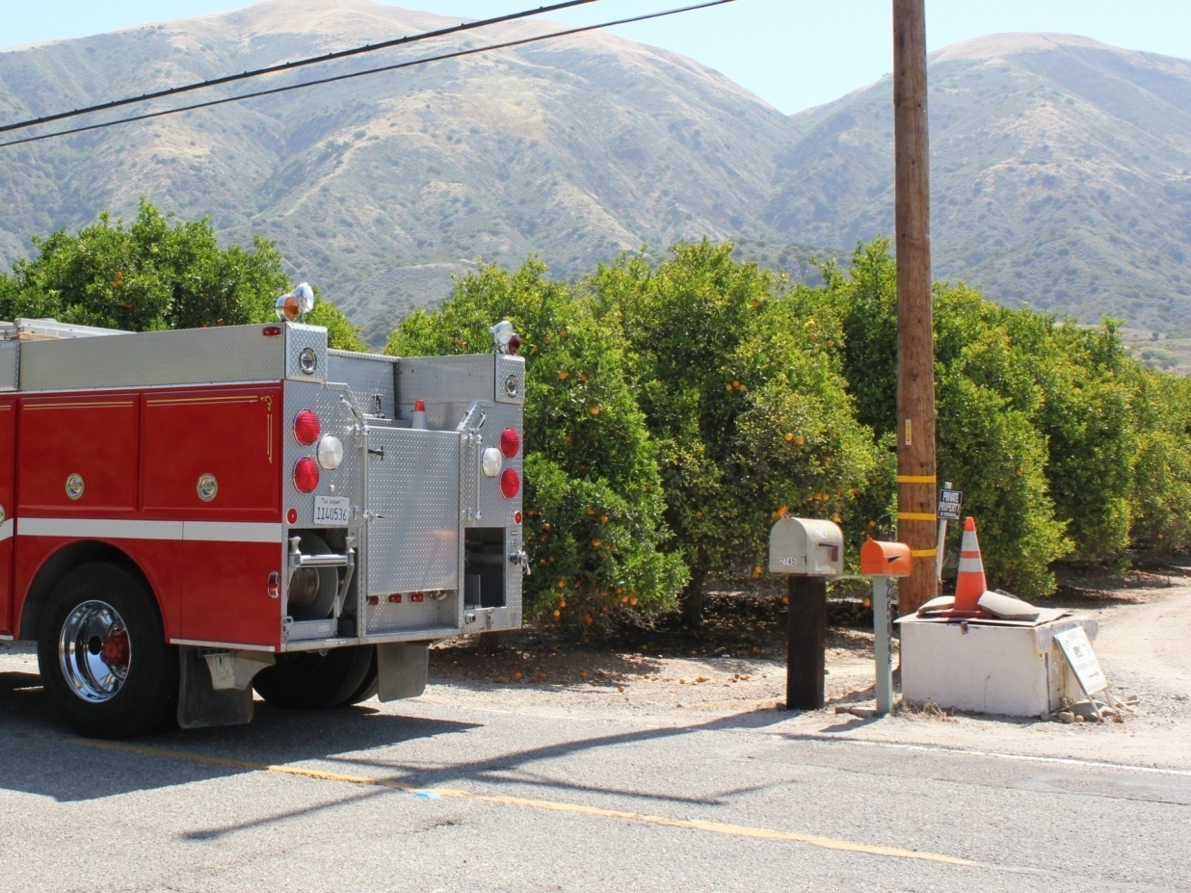
When multiple residences
are encountered in one location,
give clear direction
to each residence on the
appropriate placard.

Slide 21
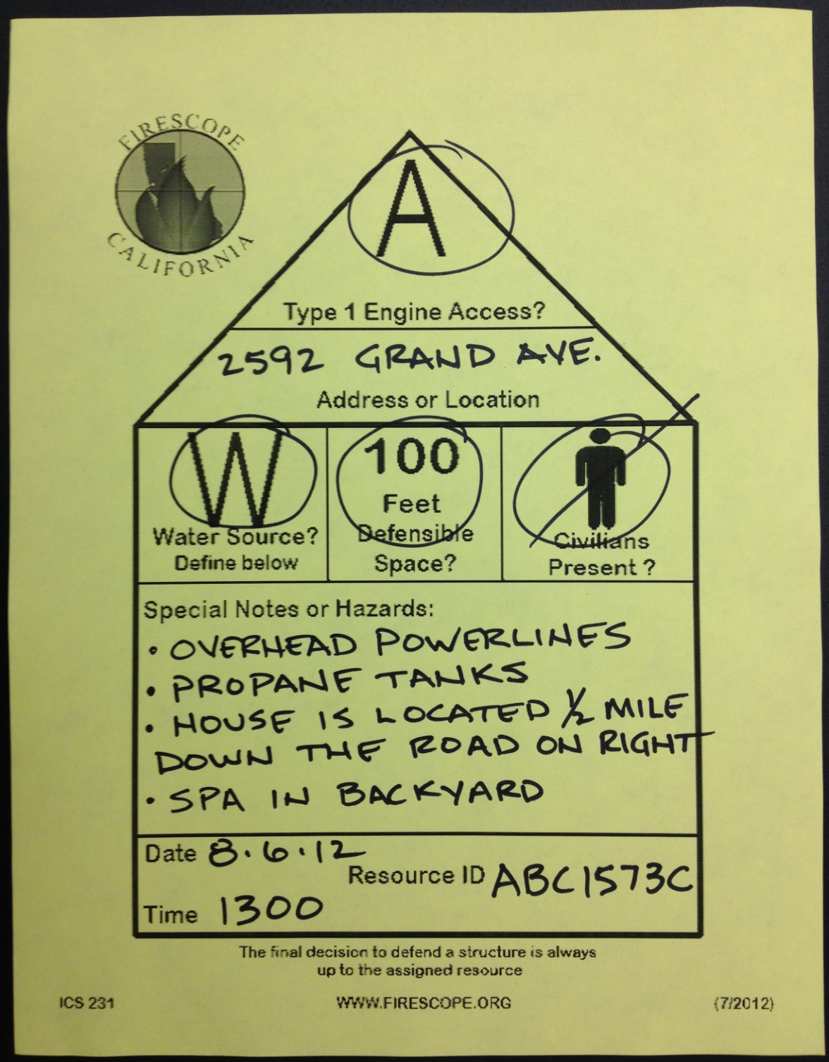
Note directions to location
of structure in the “Special
Notes or Hazards” area

Slide 22
The final decision
to defend a structure
is always up to the
assigned resource

Slide 23
WUI Placards (ICS 231) can be
downloaded from the FIRESCOPE
website at:
WWW.FIRESCOPE.ORG

