Slide 1
Monterey County Fire Chiefs Association
2011 Fireground Safety System

Slide 2
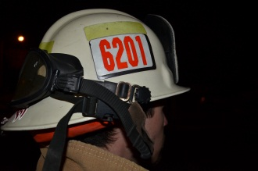
2011 Fireground Safety System
The Monterey County Fire Chiefs Association – Fireground Safety System - was revised and adopted as a “Final Approved Draft” on July 14, 2011.
The Fireground Safety System is located in Section 8 of the MCFCA Fire Operations Manual.
In addition to using the Fireground Safety System, this training should reference the following documents located in Section 8 of the Fire Operations Manual:
Firefighter Lost / Trapped / Disoriented Command Policy
Firefighter Lost / Trapped / Disoriented Policy
Programming the “Firefighter Emergency” Button on Portable Radios Policy
Appendix A: Hardware Templates
Appendix B: Accountability Officer Checklist
Appendix C: RIC Group Supervisor Worksheet
Appendix D: Critical Fireground Factors
Appendix E: IC / Operations Section Chief RIC Worksheet
Appendix F: RIC Branch Director Worksheet
Appendix G: RIC Group Supervisor Air Management Form
This training program should also include examples of individual nametags, passports, helmet identification tags, status boards, and RIC Bag contents.

Slide 3
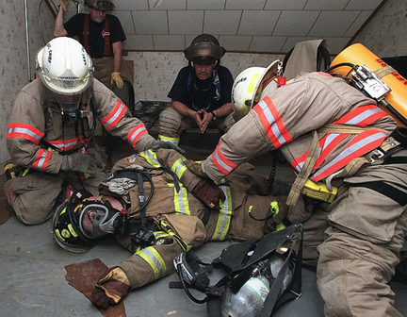
2011 Fireground Safety System
This training program is provided by the Monterey County Fire Training Officers Association to further improve the safety of firefighters while operating at an emergency incident in Monterey County.
The training should also include a practical application in IRIC / RIC operations to reinforce the procedures and concepts contained in this program.

Slide 4
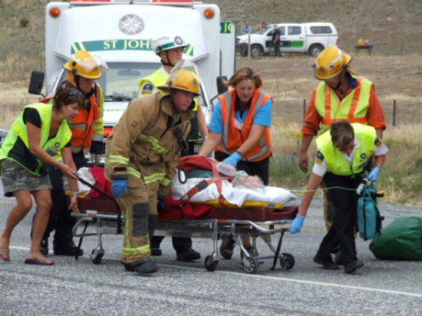
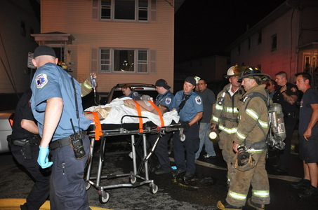
1. Introduction
Confusion on the fireground and a lack of accountability has led to tragic incidents involving firefighter fatalities.
Implementing and maintaining an effective Fireground Safety System will significantly decrease the chances of future tragedies and improve firefighter safety.

Slide 5
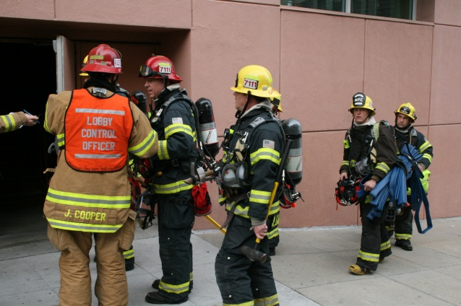
1. Introduction
Eight components to the system:
Firefighter Accountability System
Building Emergency Evacuation Signal
Personal Accountability Reports (PARs)
Missing Firefighter Procedure
Initial Rapid Intervention Crew (IRIC)
Rapid Intervention Crew (RIC)
Fire Fighter Emergency Procedures
Air Management
Due to the increasing amount of automatic aid agreements and mutual aid requests throughout the county, there is need for a standardized Fireground Safety System.

Slide 6
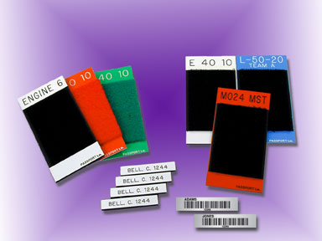
2. Firefighter Accountability System
Purpose:
To improve personal firefighter safety by accounting for all firefighters at any given time.
System Description:
System Overview
The passport system involves a nametag for each member assigned to a particular piece of apparatus affixed to a “passport.” The passport is affixed to the dashboard of the apparatus.
Additionally, each helmet displays either a four-digit resource identifier or three-letter agency identifier to aid in fireground identification.
System Hardware
Individual Nametags – attached to underside of helmet brim
Passports – displays individual nametags
Status Boards – displays passports
Helmet Identification Tags – identifies company
or agency
Hardware Template Size – standardized countywide
Appendix A - Passport and
Helmet Identification System

Slide 7
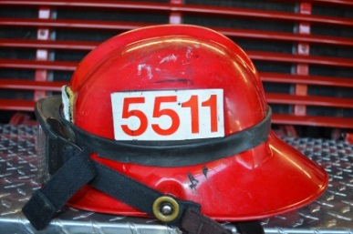
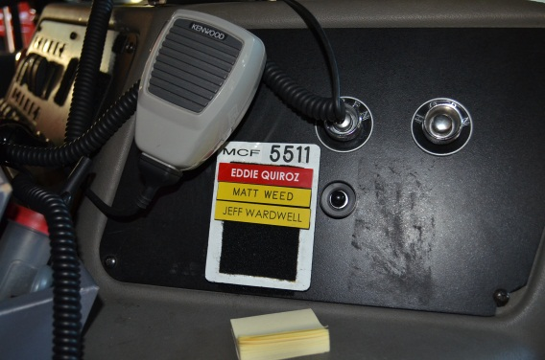
2. Firefighter Accountability System
Pre-Incident Procedures
Company Passport Set-up
Each crew member must keep the company passport updated at all times.
Order of Nametags
Company Officer
Engineer
Firefighter
Helmet Identification Tags
Arriving crewmembers must ensure the helmet identification tags reflect the company ID they are assigned to.
Company Officer’s Responsibility
Ensures that passports and helmet ID’s are current.
Passports must reflect only those members actually assigned to the company.

Slide 8
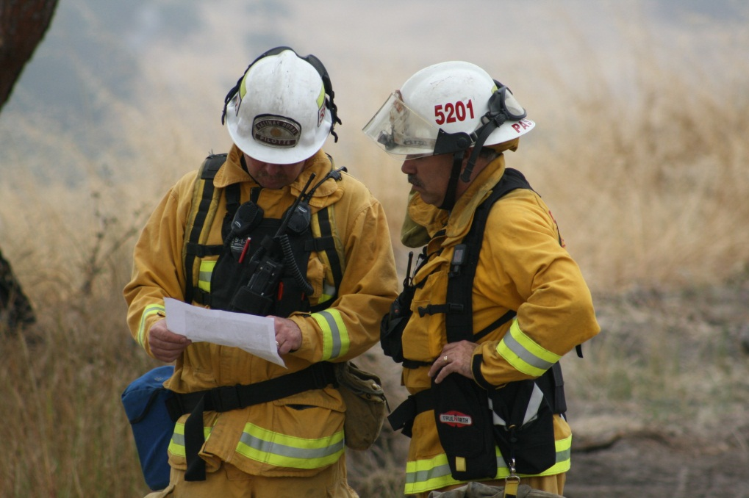
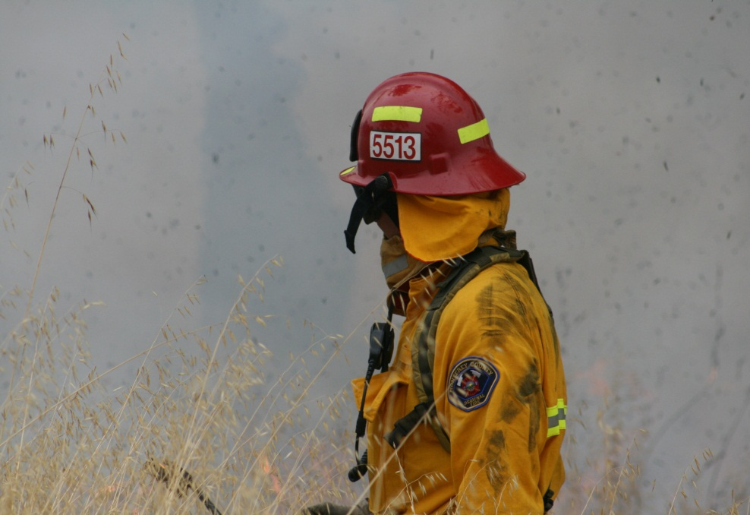
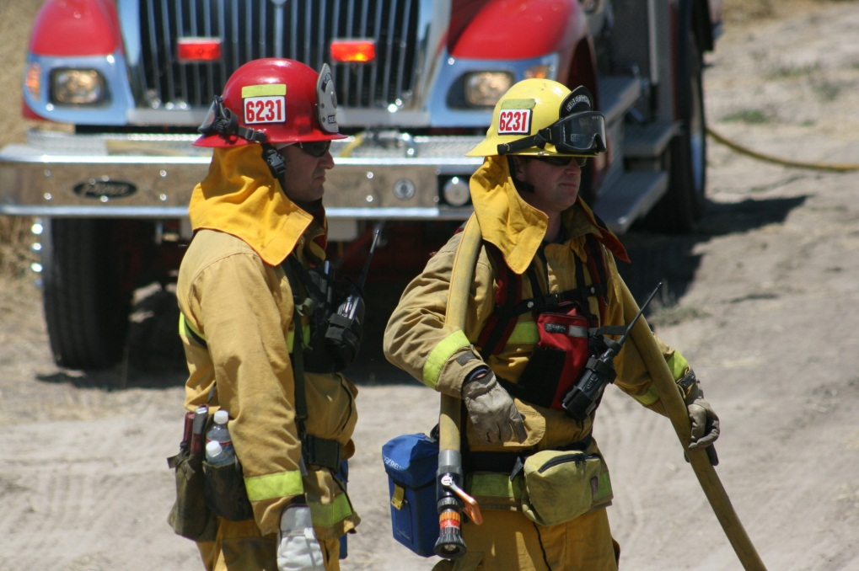
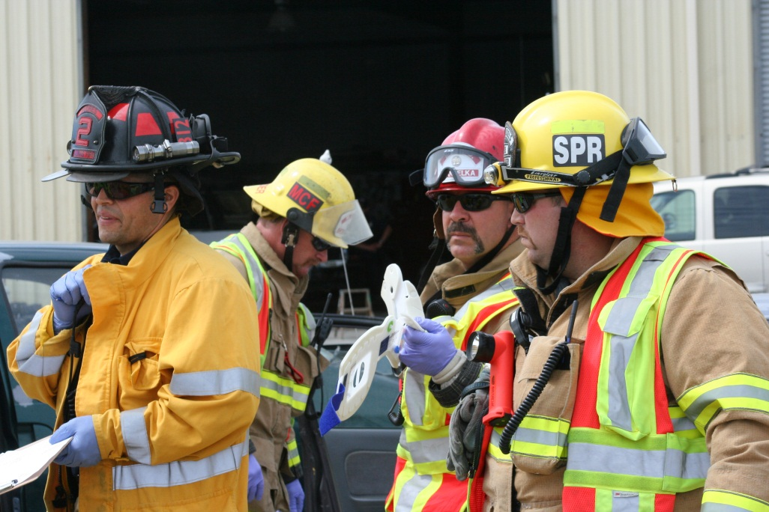

Slide 9
2. Firefighter Accountability System
Emergency Incident Procedures
Initial arriving crews may leave their passport in the vehicle. IC or assignee will collect later.
Later arriving crews should bring their passports to the ICP or staging area. (Including volunteers and off-duty personnel)
If no ICP, bring passports to the pumping engine.
For mutual aid incidents, arriving volunteers or off-duty personnel should report directly to their agency’s apparatus for assignment.
Runner or Accountability Officer collects passports.
IC completes blank passports as needed.
IC or Accountability Officer maintains passports.
Accountability Officer’s Checklist
Refer to Appendix B – Accountability Officer’s Checklist

Slide 10
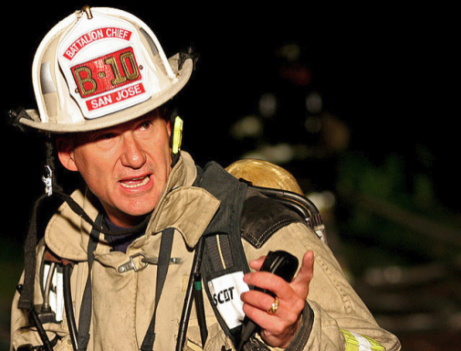
3. Building Emergency Evacuation Signal
Purpose
To provide a uniform signal alerting personnel of dangerous conditions requiring them to immediately leave the building.
Responsibility
The Incident Commander is responsible for initiating the Building Emergency Evacuation Signal when conditions have deteriorated to the point that it is too dangerous to maintain firefighting crews in the building.
The IC is also responsible for conducting a post-incident analysis whenever the signal is initiated.
Procedure
IC will initiate the “Building Emergency Evacuation Signal.”
Three components of the signal:
Radio message from the IC
Transmitted on all frequencies.
Evacuation Signal
Repeated short blasts of an air horn for
approximately 10 seconds followed by 10 seconds
of silence. Repeat this cycle three times.
Personal Accountability Report (PAR)
Initiated by IC to account for all personnel.
Appendix D – Critical Fireground Factors
Upon signal, all radio traffic stops except for PARs.

Slide 11
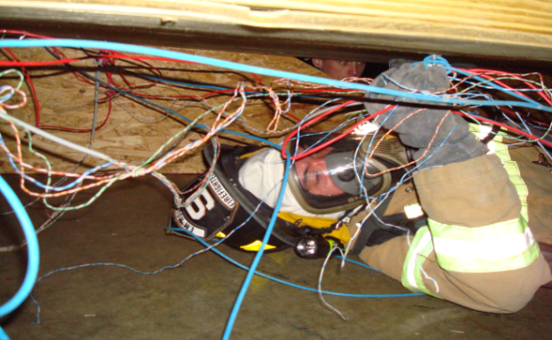
3. Building Emergency Evacuation Signal
The term “Mayday” shall be used when a crew member encounters an immediately dangerous situation.
The call should always be given three times in a row ("Mayday Mayday Mayday") to prevent mistaking it for some similar-sounding phrase under noisy conditions, and to distinguish an actual Mayday call from a message about a Mayday call.
The term “Mayday” is derived from a French word meaning “come and help me.”
The person or crew reporting a “Mayday” shall give a “N.U.C.A.N” report as follows:
Name
Unit
Conditions
Actions
Needs
The Incident Commander, Operations Section Chief, RIC Branch Director, or Rescue Group Supervisor shall communicate to the firefighter with instructions as to what the trapped or disoriented firefighter should do next.

Slide 12
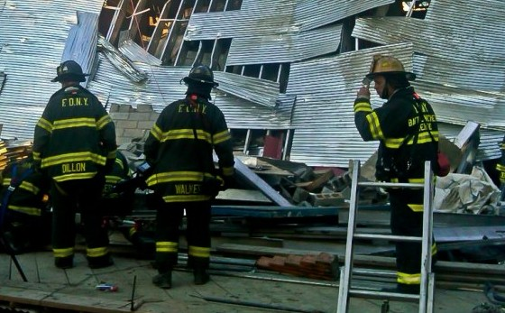
4. Personal Accountability Reports
Purpose
Roll call of personnel taken at certain benchmarks during an incident
The term “PAR” is used as part of the roll call process.
Benchmarks for Requesting PAR’s
I. A PAR should be considered when the following situations occur:
Report of missing or trapped firefighter
Any sudden hazardous event
Change from offensive to defensive
By crews reporting an “All Clear”
When the fire is declared controlled
At 20 minute elapsed intervals
Anytime IC determines it is necessary
Incident Elapsed Time Notification
Dispatch notifies the IC 10 minutes after first arriving resource and 10 minutes thereafter until the incident is controlled or the elapsed time notification is cancelled by the Incident Commander.

Slide 13
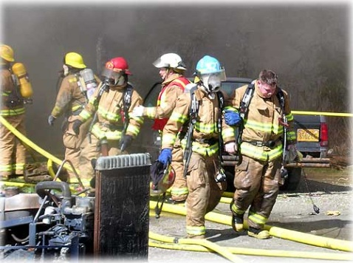
5. Missing Firefighter Procedure
Purpose
The procedure should be implemented immediately. There should be no hesitation since the window of survivability for the lost firefighter is very narrow.
Procedure:
Immediately initiate a call for PAR’s.
Always assume firefighter is lost.
Immediately send IRIC or RIC to last known location of missing or trapped firefighter.
Immediately call for additional resources as needed.
The location and rescue of the missing firefighter must become the top priority of the incident.

Slide 14
6. Initial Rapid Intervention Crew - IRIC
Purpose – Whenever interior operations are initiated in an IDLH atmosphere to meet the requirements of 29 CFR 1910.134.
Procedure - The Initial Rapid Intervention Crew shall:
Consist of two trained firefighters in full PPE and SCBA.
Have one IRIC member monitor the interior conditions.
The other IRIC member may perform other tasks.
Be immediately available at the incident.
Be equipped with a RIC Bag.
Consider additional search equipment.
Have one extra complete SCBA.
Have back-up rescue hose line immediately available.
Be assigned by the Incident Commander.
Be under the immediate control of the IC or other designee.
Stage at “point of entry” unless otherwise assigned.

Slide 15
6. Initial Rapid Intervention Crew - IRIC
Deployment:
IC or OPS deploys IRIC after receiving “Mayday” call.
IRIC proceeds to “point of entry” and establishes a positive physical connection to the entry point.
IRIC makes entry and initiates search.
Maintain positive contact with “point of entry.”
IC announces on all frequencies that IRIC has been deployed.
Consider switching non-IRIC radio traffic to VFire26.
Consider appointing an IRIC Director or Rescue Group Supervisor.
When multiple IRIC’s are being used, consider identifying crews as IRIC and unit number (IRIC 8411) or maintain identifiers as IRIC 1, IRIC 2, etc.
Consider reassigning resources to support IRIC effort.
IC should consider the need for additional resources, including EMS, to support the shift in suppression strategy.

Slide 16
7. Rapid Intervention Crew - RIC
Purpose – Whenever IC deems it appropriate due to the complexity of the incident. The RIC is intended to replace IRIC with additional dedicated personnel due to larger buildings or complex incidents. Asssignment meets requirements of 29 CFR 1910.34. (“two in / two out”)
Procedure
The RIC shall:
Consist of four trained firefighters in full PPE and SCBA.
Have at least two members monitor interior conditions.
Other RIC members may perform other tasks directly related to RIC.
Be immediately available for deployment with constant radio contact.
Be equipped with at least one (1) RIC Bag.
Consider additional equipment.
Have at least one extra SCBA or specialized RIC SCBA.
Have a back-up or rescue hose line immediately available.
Be assigned by the Incident Commander.
Be under immediate control of the IC, OPS, RIC Branch Director, or Rescue Group Supervisor.
Stage at “point of entry” unless otherwise assigned.

Slide 17
7. Rapid Intervention Crew - RIC
Deployment Procedure:
Upon receipt of a “Mayday” or firefighter down button activation, the IC or OPS shall deploy the RIC to the last know location of the distressed firefighter or crew.
Proceed to “point of entry” and establish a positive physical connection to point of entry. (hose line, rescue rope)
Make entry and initiate search and rescue.
Maintain positive physical contact with “point of entry.”
RIC Leader shall be in command of search and rescue operation.
IC announces to entire fireground that RIC has been deployed and identifies RIC tactical frequencies.
IC should consider switching all non RIC radio traffic to Vfire26.
IC should consider appointing RIC Branch Director or RIC Rescue Group Supervisor to manage the RIC operations.

Slide 18
7. Rapid Intervention Crew - RIC
Consider using RIC term and unit identifier (RIC 5411) when multiple RIC’s are deployed, or maintain a system of RIC 1, RIC 2, RIC 3, etc.
IC should consider re-assigning resources to support the RIC operation.
IC should consider the overall need for additional resources, at least one strike team and EMS, to support the RIC operation and the shift in suppression strategy.
Appendix C – RIC Group Supervisor – RIC Worksheet
Appendix E – IC / Operations RIC Worksheet
Appendix F – RIC Branch Director Worksheet

Slide 19
8. Emergency Fire Fighter Procedure
Firefighter:
If lost, trapped, or disoriented, use the term “Mayday, Mayday, Mayday” and / or activate the Emergency Firefighter Down Button.
Do not delay the radio report
If unable to transmit, use the Emergency Firefighter Down Button.
After acknowledgement, provide a “N.U.C.A.N” Report.

Slide 20
8. Emergency Fire Fighter Procedures
Most importantly, the firefighter needs to remain calm, conserve air, and clearly communicate with fellow rescuers and command.
Firefighters finding themselves lost or disoriented shall take the following actions:
Maintain radio contact with rescuers and command.
Activate PASS device.
Follow hoselines or lifelines out.
Search for a way out by whatever means possible.
If escape is not possible, retreat to a safe area and communicate the action to command and rescuers.
Stay calm and conserve air.
Assume a supine position that allows for maximum audible effect of PASS device.
Use flashlight beam or make tapping noises to attract the attention of rescuers.

Slide 21
8. Emergency Fire Fighter Procedure
Company Officer / Crew Member / Division Supervisor
If a firefighter is determined to be unaccounted for, trapped, or lost, use the term “Mayday, Mayday, Mayday” over the radio.
Crews operating in the general area should take any and all actions necessary to locate, assist, and remove the firefighter from the hazardous environment upon approval from the IC or Operations Section Chief. (if assigned)

Slide 22
9. Air Management
Air management is critical during a Fire Fighter Emergency and IRIC / RIC deployment and should constantly be evaluated by the Incident Commander, or Operations Section Chief, Rescue Group Supervisor, to ensure the air management of rescue crews.
Appendix G – Air Management Form

