Slide 1
Assistance to Firefighters
Grant Program
2011

Slide 2
Presenter
Name, Fire Program Specialist
First.Lastname@dhs.gov
Office: (xxx) xxx-xxxx Cell: (xxx) xxx-xxxx
Notes:
2

Slide 3
Assistance to Firefighters
Grant Program
The purpose of the Assistance to Firefighters Grant (AFG) Program is to enhance the ability of first responders to protect the health and safety of the public from fire and related hazards.

Slide 4
AFG Offers Three Grant Programs
Assistance to Firefighters Grants
Staffing for Adequate Fire and Emergency Response Grants
Fire Prevention and Safety Grants

Slide 5
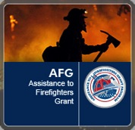


Total FY 2011 Appropriation
AFG $370 million
SAFER $405 million
FP&S $35 million

Slide 6
Eligible Applicants
Fire Departments
Nonaffiliated EMS

Slide 7
Required Cost Share (Local Match) is Based on Population
Population less than 20,000
5%
Population 20,000 to 50,000
10%
Population 50,000 or greater
20%

Slide 8
Maximum Funding Levels
Population of 500,000 or less
$1,000,000
Population between 500,000 and 1 million
$1,750,000
Population of more than 1 million
$2,750,000

Slide 9
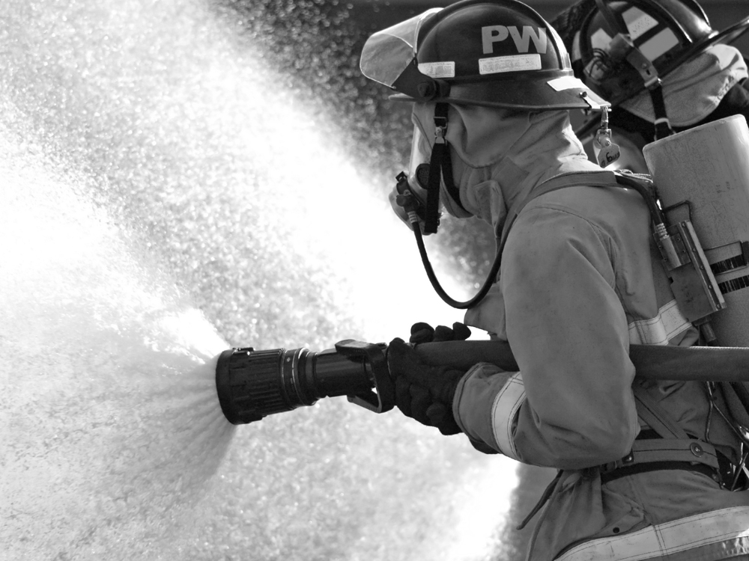
What’s New for 2011?

Slide 10
Exciting New Changes
The Guidance is shorter, more user friendly, and highlights the funding priorities. (High, Medium, Low)
Changes were made to application questions to enhance the panelists’ ability to review each application’s merits.
Total application score is now 50 percent from the electronic prescore and 50 percent from the panelists’ scores for all projects.
Quick reference guides have been provided.
AFG is partnering with the National Fire Protection Association (NFPA) by providing a limited free Web link to the NFPA guidelines.

Slide 11
DUNS, CCR, and SF-425 Updates
Central Contractor Registration (CCR)
Since October 1, 2003, it has been federally mandated that any organization wishing to do business with the Federal government under a FAR-based contract must be registered in CCR before being awarded a contract. This includes applicants and grantees for the AFG Program.
For “New Registration" go to:
www.bpn.gov/ccr/grantees.aspx

Slide 12
DUNS, CCR, and SF-425 Updates
In Summary
A DUNS number is required to apply for a grant and to register with the CCR.
CCR registration is NOT required to apply for a grant, but you must be registered to be awarded a grant.
If your city already has a DUNS number, check first to see if it has already registered in the CCR and if its CCR is current.
CCR registrants must revalidate their registration at least once a year to maintain an active status.

Slide 13
Semiannual Programmatic and SF-425 Financial Reports
The SF-425 Financial Report is required semiannually based on the calendar year. The SF-425 Financial Report is required semiannually based on the calendar year, every June 30 and December 31. If you miss a report date payment requests will not be approved.
  The AFG Semiannual Programmatic Progress Report is due six months after the grant award date. Both reports should be submitted as scheduled, even if they are both due in the same month.
  Both reports should be submitted as scheduled, even if they are both due in the same month.

Slide 14
Application Scoring
Each project in your application will be scored on its own merits, provided it meets the funding priorities set by the AFG’s Criteria Development Group.
This year, 50 percent of your final score will be from the electronic prescore, and 50 percent will be from an average of the Peer Review Panelists’ scores.

Slide 15
Application Scoring
Example :Your application has three projects.
Project 1: Replace Old, Outdated SCBA
– Electronic Prescore 91
– Peer Reviewers’ Score 89
Project 2: Purchase P-25-Compliant Radios
– Electronic Prescore 94
– Peer Reviewers’ Score 84
Project 3: Generator for Unoccupied Substation
– Electronic Prescore 50
NOT PANELED ---

Slide 16
Application Scoring
The score for each project will carry the same weight: 50 percent will be from the electronic prescore and 50 percent will be from an average of the Peer Review Panelists’ scores. (The Generator Project will not be paneled).
The final score will be based on two projects. The generator project will be disregarded.
SCBA (91 + 89) 180 ÷ 2 = 90
Radios (94 + 84) 178 ÷ 2 = 89
One or both projects might be funded.

Slide 17
Environmental and Historic Preservation (EHP) Review
FEMA is legally required to consider the potential impact of all grant-funded projects on environmental resources and historic properties. This is accomplished via FEMA’s EHP Review.
Grantees must comply with all applicable EHP laws, regulations, and Executive Orders. No project with the potential to impact natural resources or historic properties can begin until FEMA completes the required EHP review.
Grantees who start projects before receiving EHP approval from FEMA risk deobligation of funds.

Slide 18
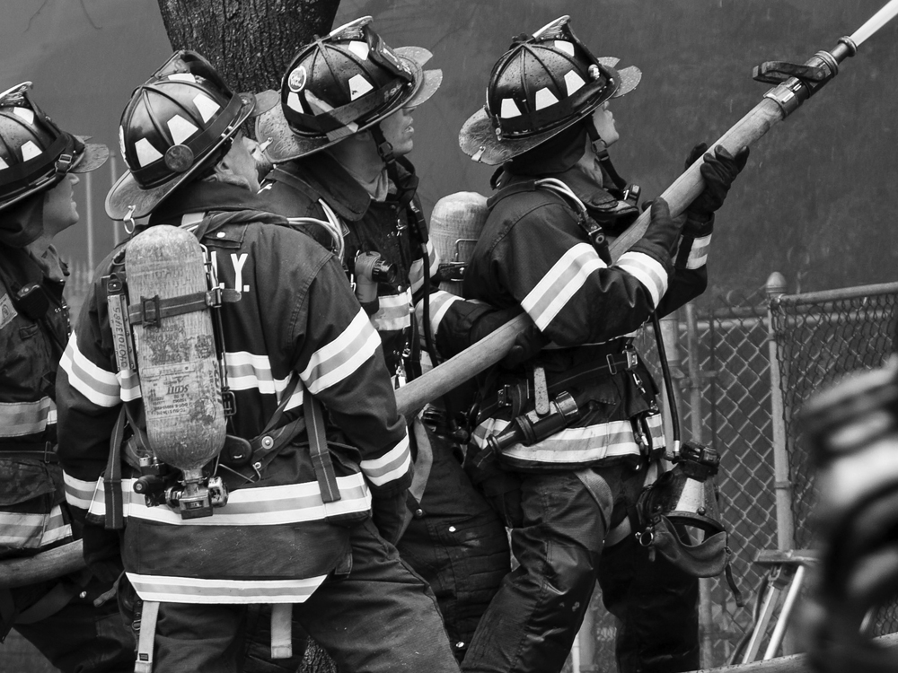
Questions

Slide 19
Application Changes
In the Applicant Information section you will be asked to
  Describe your organization and/or the community you serve.

Slide 20
Application Changes
  Applicants will no longer be asked to write a single Narrative Statement for their entire application.
  Applicants now will provide Narratives specific to each Request Details Activity.

Slide 21
Application Changes
  In the Request Details section for each activity, e.g., Training, Equipment, you will be asked to provide written Narratives. You will write Narratives in four separate text boxes as they relate to the requested activity:
  Project description
  Cost benefit
  Statement of effect of the funds, and
  Additional information.

Slide 22
Application Changes
  Fire department applicants and regional applicants will be asked to indicate the total amount of funds being requested for EMS materials in the Request Details section for each activity.
  This question will not be scored and will not be counted toward your project budget. It is being asked for information purposes only.

Slide 23
Community Risk Assessment
Look at:
History: Trends – frequency – severity
Current: Financial – core mission – political
Future: Possibilities – probabilities – certainties

Slide 24
Application Changes
Financial Need
Your organization’s financial need for the grant, which formerly was discussed in the Narrative Statement, now should be discussed earlier in the Department Characteristics (Part II) section of the application.

Slide 25
Financial Need
In Department Characteristics (Part II), explain:
Why do you need money from the Federal Government?
Why can’t you complete this project without Federal funds?
Describe your income compared to expenses to illustrate current funding deficiencies.

Slide 26
Financial Need
Explain other attempts you have made to fund department needs (e.g., fundraisers, donations, funds from insurance, taxes, fees for service or subscription service).
Explain financial and community trends or changes (shrinking economy or rapid growth).

Slide 27
Application Changes
In Department Characteristics (Part I)
  You will be asked whether the department is compliant to the National Incident Management System (NIMS) requirements.
In Department Characteristics (Part II)
  You will be asked to give the percentage of your annual budget that comes from
    EMS Billing
    Fees for Services other than EMS billing (e.g., vehicle extrication)

Slide 28
Vehicle Changes
Applicants may request multiple vehicles, but the total amount requested will be limited to their financial cap, which is based on population.
Ambulances are now included as a High Priority under Fire Department Vehicles.

Slide 29
Personal Protective Equipment Changes
Applications for turnout gear may now request complete sets or list the individual pieces of the turnout ensemble needed.
In requests for Self-Contained Breathing Apparatus (SCBA), the highest priority will be given to replacing SCBA manufactured before the 2002 Edition of NFPA 1981.

Slide 30
Wellness and Fitness Changes
A Behavioral Health Program is now required as one of the four primary activities to receive a wellness and fitness grant.
If your department does not currently offer a Behavioral Health Program, you must request funding to establish such a program before requesting other wellness and fitness projects, such as fitness equipment.

Slide 31
Training Changes
Stand-alone Flashover Simulators are no longer eligible for funding.
However you can still request commercially manufactured Mobile Burn Trailers.

Slide 32
Regional Application Changes
New this year is the ability to request Personal Protective Equipment (PPE) as a Regional Project.
Turnout gear and SCBAs are now eligible, but all departments participating in the Regional Application will be reviewed for previous SCBA grant awards.

Slide 33
Equipment Changes
Extended warranties and service agreements, when offered, are now eligible on all items.
Boats 20 feet or less in length are now eligible for funding as an Equipment Project.

Slide 34
Questions

Slide 35
AFG Program Areas
Up to three separate funding applications may be submitted:
  Operations and Safety
  Vehicle Acquisition
  Regional Projects

Slide 36
Funding Priorities
Always check the Funding Priorities in the Program Guidance before deciding on the items or projects for which you will request assistance.
The AFG Program Guidance can be accessed at http://fema.gov/firegrants.

Slide 37
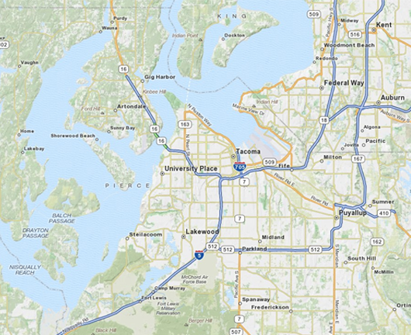
Primary Response Area
For application purposes, use statistics for your own first-due/response area. In the application, be sure to list accurately your department’s square mileage. Inaccurate answers to this question may void your application.
Automatic or mutual aid calls do not count toward your first-due area. You will list them separately at the bottom of the Call Volume page.

Slide 38
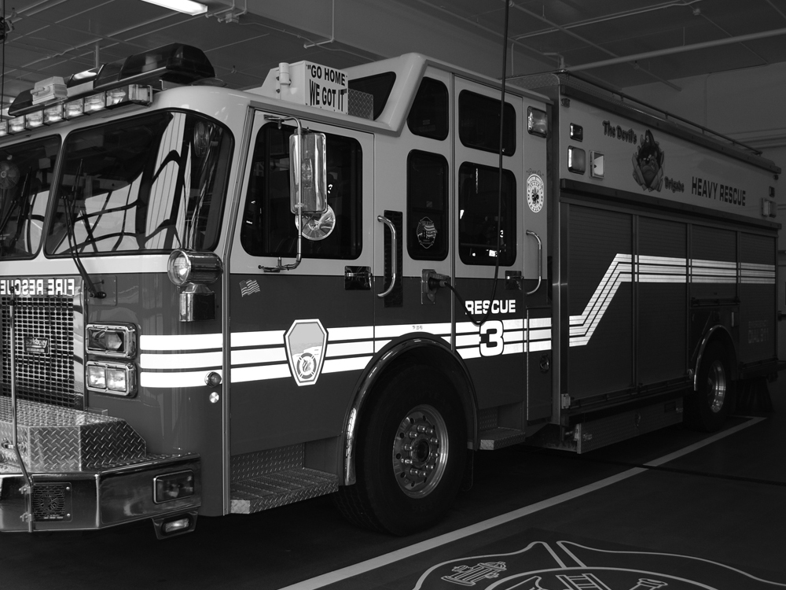
Fire Department Vehicle
Acquisition Activity

Slide 39
AFG Vehicle Grants
Previous vehicle awardees are eligible to apply in 2011.
Fire departments and nonaffiliated EMS organizations that protect urban, suburban and rural areas or communities may request multiple vehicles in a single application.
A variety of vehicles may be requested. However, selecting lower priority vehicles will decrease your application’s competitiveness.

Slide 40
Fire Apparatus Priorities
Priority | Urban Communities | Suburban Communities | Rural Communities
1 (H) | Pumper Ambulance Aerial Quint (Aerial <76’) Quint (Aerial >76’) Rescue | Pumper Ambulance Aerial Quint (Aerial <76’) Quint (Aerial >76’) Tanker/Tender | Pumper Ambulance Brush/Attack Tanker/Tender Quint (Aerial <76’)
2 (M) | Command Hazmat Light/Air Rehab Foam Truck | Rescue Command Light/Air Hazmat Brush/Attack | Command Hazmat Rescue Light/Air
3 (L) | ARFF Brush/Attack Foam Truck Fire Boat Tanker/Tender Highway Safety Unit | ARFF Rehab Highway Safety Unit Fire Boat Foam Truck | Foam Truck Arial Highway Safety Unit ARFF Rehab Fire Boat

Slide 41
Equipment
Items requested in the Equipment category should meet any regulatory requirements and National Fire Protection Association or Department of Homeland Security-adopted standards.

Slide 42
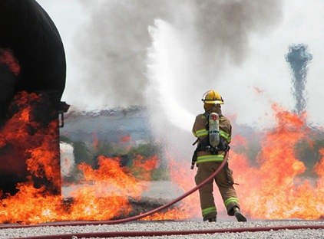
Training
In Department Characteristics (Part I),
Fire department applicants will be asked to indicate the percentage of active firefighters trained to Firefighter I and Firefighter II.
If less than 100 percent are trained to those standards, applicants will be asked if their application will request a training grant to reach full compliance.

Slide 43
Training
If the applicant is not requesting a training grant to reach 100 percent compliance with the NFPA standard, the department will be asked to describe its plans to achieve full compliance with the standard.

Slide 44
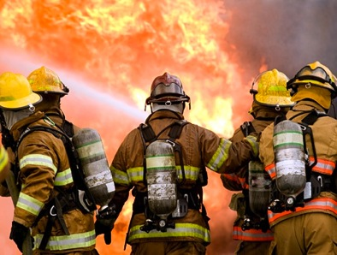
Personal Protective Equipment
You will be asked to provide significant detail about your existing equipment inventory.
The age of your existing equipment will be considered in all phases of review.

Slide 45
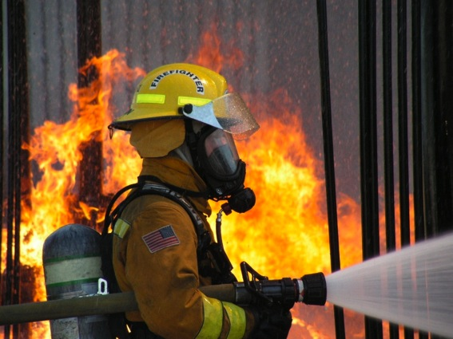
Self-Contained Breathing Apparatus
Applicants with significant numbers of older, non- compliant SCBA are a higher priority for funding.
Applicants with SCBA that are compliant with the more current editions of NFPA 1981 (the 2002 and 2007 Editions) are a lower priority.

Slide 46
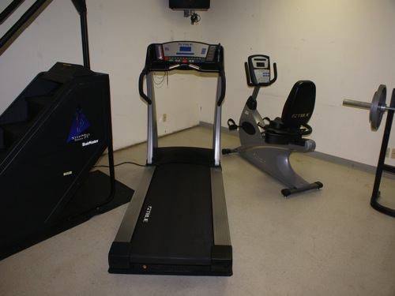
Wellness and Fitness
Entry-level physicals (NFPA 1582)
Immunizations
Periodic health screenings
Behavioral health programs

Slide 47
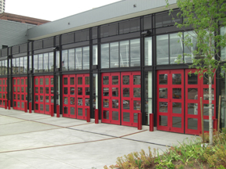
Modification to Facilities
Sprinkler systems
Smoke, fire alarm notification systems
Source-capture vehicle exhaust systems
Air quality systems
Emergency power generators
Vehicle-mounted exhaust filtration systems
Note: Grants will not be provided to modify buildings constructed after 2003.

Slide 48
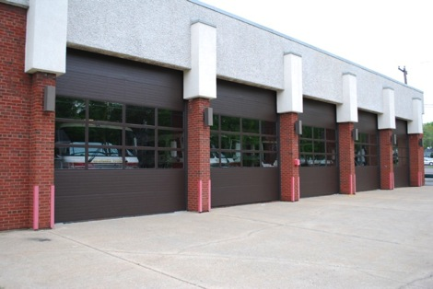
Modification to Facilities
Funding Priorities
    Requests for direct source-capture systems, sprinkler and smoke/fire alarm systems
    Stations with sleeping quarters and/or occupied 24/7
Additional Considerations
    Age of the building – older buildings receive higher priority for funding
Note: Grants will not be provided to modify buildings constructed after 2003.

Slide 49
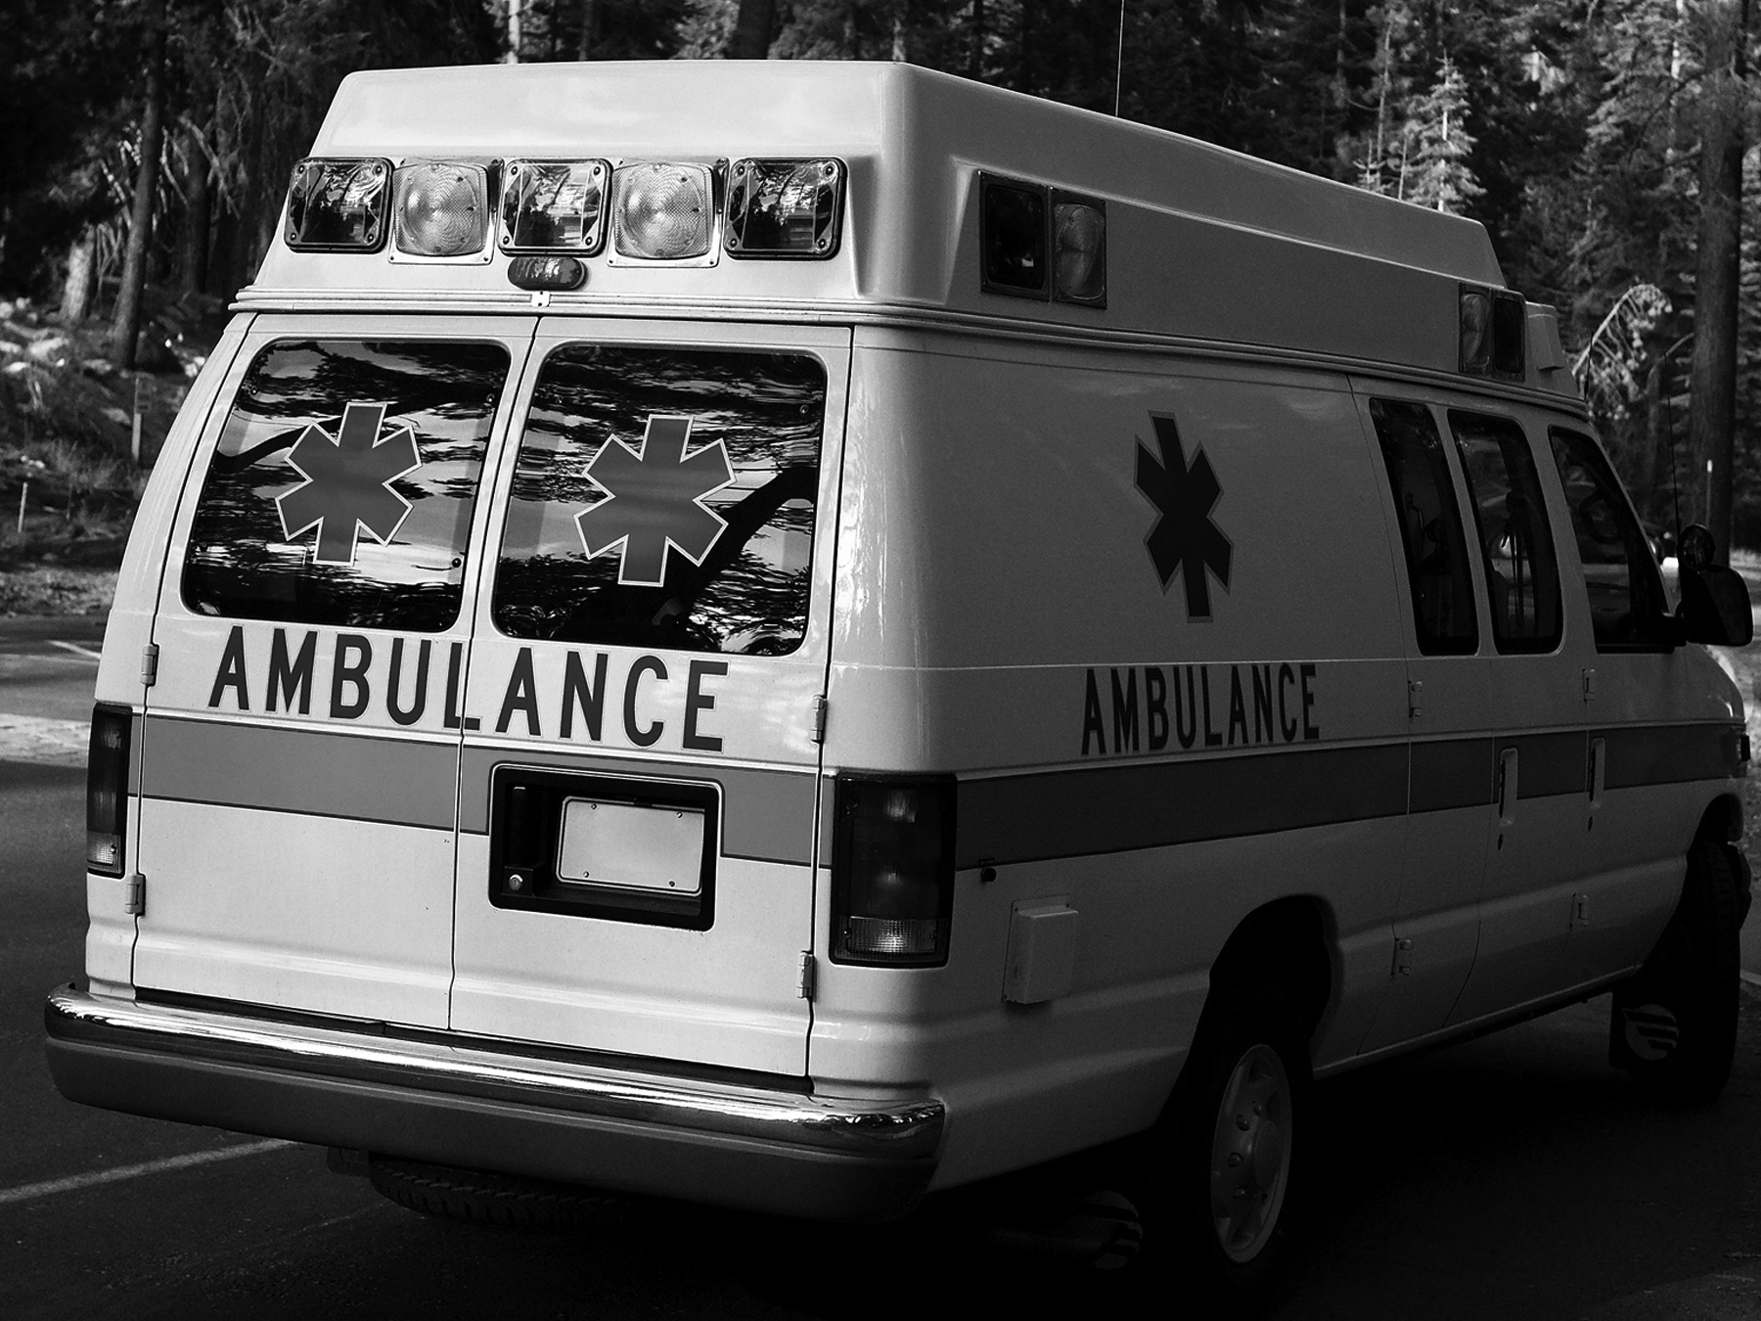
EMS
Applications

Slide 50
Nonaffiliated EMS
A nonaffiliated EMS is a public or nonprofit emergency medical service organization that provides direct emergency medical services, including emergency medical transport to a specific geographic area on a first-due basis, but is not affiliated with a hospital and does not serve a geographic area where EMS is adequately provided by a fire department.

Slide 51
Ineligible Organizations
EMS organizations and rescue squads that do not transport
Fire-based EMS organizations
Hospital-based or -affiliated EMS

Slide 52
EMS Applications
Up to three separate applications may be submitted:
  EMS Operations and Safety
  Vehicle Acquisition
  Regional Projects

Slide 53
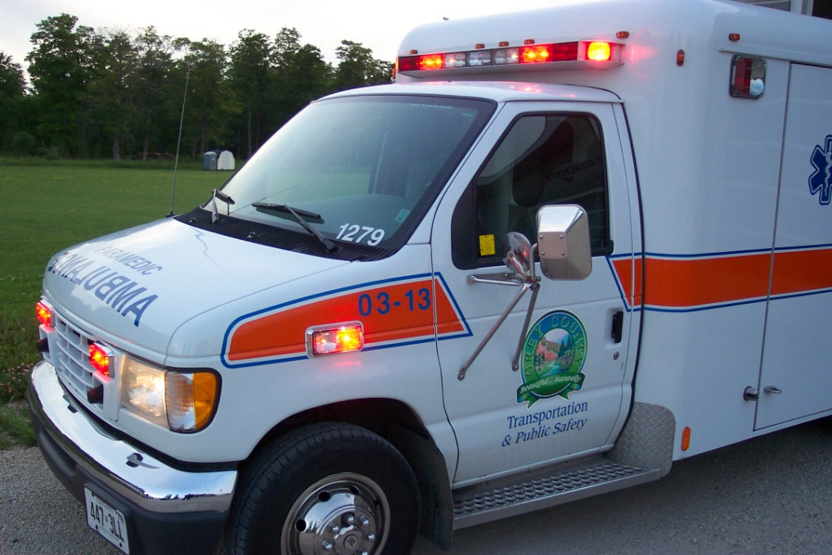
EMS Vehicles
A total of $1.85 million is available.
Applicants may request multiple vehicles.
Requests are limited to the financial cap.

Slide 54
EMS Vehicle Priorities
Priority One
(H)
Priority Two
(M)
Priority Three
(L)
Ambulances or transport units to support EMS
First Responder non-transport vehicles
Other specialty vehicles
Operations vehicles (Hazmat, rescue)

Slide 55

EMS Operations and Safety Activities
Personal Protective Equipment
Training
Equipment
Modifications to Facilities
Wellness/Fitness Services

Slide 56
Ineligible Activities
Firefighting equipment
EMS expendables (gloves, medicines, etc.)
ALS equipment for BLS organizations
Construction
Wildland and structural PPE

Slide 57
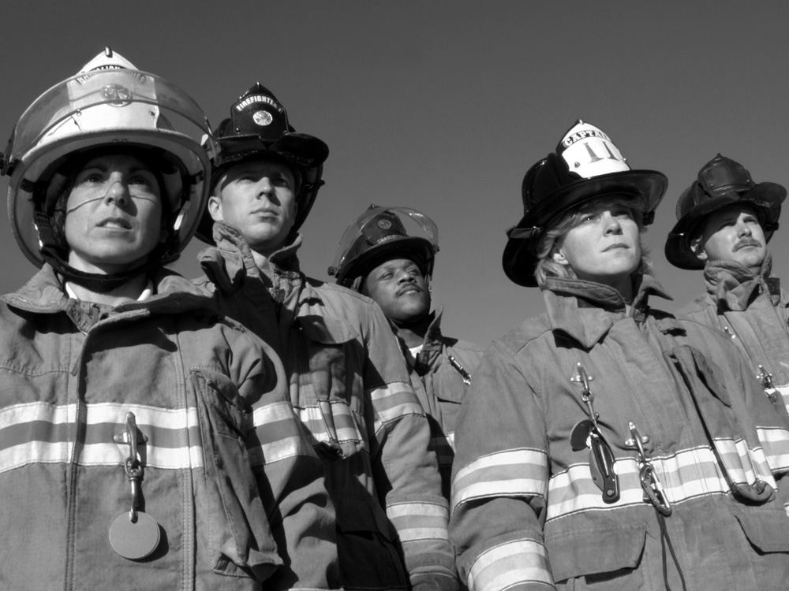
Regional
Applications

Slide 58
Regional Applications
Any eligible organization may act as a host for a regional application.
A regional project is one in which multiple organizations serving more than one local jurisdiction benefit directly from the activities implemented with the grant funds.

Slide 59
Eligible Regional Grant Projects
Communications projects
Training
Equipment
PPE/SCBA

Slide 60
Questions

Slide 61
Planning Your Application
Risk: Exposure to the chance of injury or loss; a hazard or dangerous chance
What are the Risks in your community?
    Aging structures not built to any standard or fire code
    Lack of adequate water supply
    Hazardous materials
    Major transportations routes, such as interstate highways or railways

Slide 62
Determine Your Capabilities
Are you sufficiently equipped to safely respond to your community’s risks?
Where and when are your responders and citizens vulnerable?
Would the operational condition of your equipment and infrastructure put your responders and citizens at risk?

Slide 63
Planning Your Application
Program Priorities
After you have determined the risks in your community, assess your capability to address those risks.
Then match your risks and capabilities to the Program Priorities found in the FY 2011 Program Guidance for your project.

Slide 64
Planning Your Application
Apply for only top priority items that address your organization’s highest risk or need.
Plan to complete and submit your application well in advance of the closing date.

Slide 65
Planning Your Application
Use the team approach to developing your application and Narrative responses for the Request Details activities.
Enlist a third-party individual who is not involved in the writing process to review and evaluate the clarity and reasonableness of your application.

Slide 66
Planning Your Application
Understand the program priorities for your target activities.
Understand the Request Details questions and how they relate to the program priorities.
Research your answers.
Determine where there is a match.

Slide 67
Developing Narratives for the Request Details Section
Applicants will be asked to provide Narratives for each activity requested in the Request Details section.
Once an applicant enters a line item for an activity, a link will appear for entering the Narratives for that activity.
By selecting the link, the applicant will be directed to complete four separate text boxes: Project Description, Cost Benefit, Statement of Effect, and Additional Information.
These four text boxes must be completed for each activity being requested.

Slide 68
Developing Narratives for the Request Details Section
Example:
The first line item you are requesting in the Personal Protective Equipment activity is 20 SCBAs. Once you enter that line item, a link will appear for you to enter the four Narratives.
You will complete the Narratives once for each activity regardless of the number of line items you request.
If you request funding in PPE and Training, you will need to submit four Narratives for both PPE and Training – a total of eight Narratives.

Slide 69
Developing Narratives for
Request Details Activities
Four critical elements must be addressed in each Narrative for each activity:
    Project Description
    Cost Benefit
    Statement of Effect
    Additional Information

Slide 70
Content of Narratives
Project Description: What you are requesting funding for, including description of the major budget items, i.e., personnel, equipment, contracts, etc.?
Cost Benefit: What benefits will your department or community realize if the project described is funded? Provide justification for the budget items relating to the cost of the requested items.
Statement of Effect: How will this award affect the daily operations of your department? How will it affect your department’s ability to protect lives and property?
Additional Information: Provide details about your request that were not covered in any other section or that deserve to be emphasized.

Slide 71
Project Description
How much will it cost?
Do you have the training for items requested or will you require training?
Describe any special issues.
Explain the identified risk and problem?
What is your solution or remedy?

Slide 72
Cost Benefit
Explain the anticipated benefits of the grant funds as opposed to the costs involved.
Discuss frequency of use vs. cost.
Describe any projected increases in efficiency of operations.
Describe any anticipated improvements in interoperability.
Explain the consequences of not receiving the award.

Slide 73
Statement of Effect
How will this grant improve firefighter safety and reduce loss of life and property?
Discuss the grant’s benefits related to frequency of use.
Describe how you will measure the results of your project and the effects of the grant.

Slide 74
Additional Information
Include any information about your department or project you feel would enhance or help justify your grant request.
Re-state why it is important that your particular application be funded. Why is it critical?

Slide 75
Key Points
Remember, your peers will be reading your Narrative responses, therefore, write so that your need is clear.
Relate only local information – not national statistics.
Provide information the reviewers do not know, e.g., information unique to your community or area that might influence how your peers view your application.
Do not use brand names.

Slide 76
Helpful Hints
Write and edit the Narratives offline. Cut and paste the text into the text boxes of the online application.
Seek a third-party or outside individual to review the application.
Make sure you have provided four Narratives for each activity in the Request Details section before you submit your application.
Avoid using templates and brand names in Narratives.

Slide 77
Helpful Hints
Be specific and to the point.
Apply for eligible, high-priority items.
Re-state important details from earlier sections of the application.
Make sure the data in the Narratives are consistent with the rest of the application.
Review all application information before submission.

Slide 78
Planning Your Application:
Program Funding Priorities
The single most important thing you can do to ensure your department has the best opportunity for success in the AFG Program is to match your highest needs to AFG funding priorities.

Slide 79
Remember
Once the application has been submitted, It Cannot Be Changed.
Follow the Program Priorities!

Slide 80
FY 2011
Staffing for Adequate Fire and Emergency Response Grants (SAFER)

Slide 81
FY 2011 SAFER Funding
$405 million
Anticipating a July or August 2011 Application Period

Slide 82
SAFER
Purpose and Goal
Purpose: Provide financial assistance to help departments increase the number of frontline firefighters.
Goal: Assist fire departments with staffing and deployment capabilities so they may respond to emergencies and assure communities have adequate protection from fire and fire-related hazards.

Slide 83
SAFER Hiring And
Recruitment and Retention
Hiring New Firefighters: To increase the number of front-line staffing.
  FY 2011 SAFER guidelines are still being developed.
    Visit www.fema.gov/firegrants for updated information.
Recruitment and Retention of Volunteer Firefighter Grants Activities: To bring about a net increase in the number of trained, certified, and competent firefighters, or to retain current firefighters.

Slide 84
The SAFER Narrative Statement
Your SAFER application can include more than one activity.
    In the Narrative, each activity should be described independently of the other.
    By listing each activity separately, the peer reviewers may see merit in one or all of the activities.
    An award may be made in whole or in part depending on the value of the activities.

Slide 85
SAFER Eligible Applicants
Hiring Activity
  Career Fire Departments
  Combination Fire Departments
  Volunteer Fire Departments
  Note: Municipalities and fire districts may apply on behalf of departments lacking the ability or legal status to apply on their own.

Slide 86
SAFER Eligible Applicants
Recruitment and Retention of Volunteer Firefighters Activity
    Volunteer Fire Departments
    Combination Fire Departments
    State and local organizations with an interest in volunteer firefighters

Slide 87
Hiring Grant
Eligible Costs
In volunteer and mostly volunteer combination departments, SAFER-funded firefighters may:
    Work a 40-hour per week schedule instead of a 24-hour shift schedule
    Have collateral assignments, e.g., fire chief, training officer, fire inspector, public educator
    Be the department’s first career firefighter

Slide 88
Recruitment and Retention Grant
Eligible Activities
Insurance packages [accidental death and dismemberment (AD&D), disability, health, dental, life, etc.]
Salary and benefits for a Recruitment and Retention coordinator
Explorer, cadet, and/or mentoring programs

Slide 89
Recruitment and Retention
Eligible Activities
Reimbursement of costs incurred by firefighters while attending required training, including compensation for lost wages, mileage, lodging, and per diem.
Stipends such as fuel reimbursement for responding to incidents or other operational activities.
Marketing costs to recruit new volunteer members.

Slide 90
Recruitment and Retention Grant
Eligible Activities
Do not be afraid to select Other. Be sure to describe the activity and how it meets your department needs.
Length-of-service awards (non-cash awards) and other retirement benefits (based on participation)
Cash awards based on operational awards

Slide 91
Recruitment and Retention
Eligible Activities
Tuition assistance is available for higher education, including college tuition and professional certifications (more than what the department typically funds for required minimum staffing firefighter certification).

Slide 92
FY 2011 Fire Prevention and Safety and Firefighter Research and Development Grants
(FP&S)

Slide 93
FY 2011 FP&S Funding
Funding $35 million
Tentative application period in winter 2011–2012

Slide 94
FP&S Eligible Applicants
Fire departments and nonprofit organizations that have experience and expertise in fire prevention programs can apply under the Fire Prevention and Safety activity.
Fire departments are not eligible to apply under the Research and Development activity.

Slide 95
FP&S Eligible Categories
Applicants may apply under the following categories:
  General Education/Awareness
  Code Enforcement/Awareness
  Fire and Arson Investigation
  National/State/Regional Programs and Studies

Slide 96
The FP&S Narrative
Fire Prevention and Safety Applications can contain more than one project (up to three), such as home fire safety for children, fire extinguisher training for local business’ and code compliance for the community.
  Be sure the narrative for each activity is clearly defined and completely independent of the other.
  List each activity separately to enable the peer reviewer to rate each activity based on its potential value based on program priorities.
  Project(s) may be funded based on the merits of the specific activity.

Slide 97
FP&S Eligible Projects
Examples of Eligible Projects
  General prevention/awareness
  Smoke alarm installation
  Juvenile fire setter projects
  Sprinkler awareness
  Public education
  Code enforcement/awareness
  Fire and arson investigation

Slide 98
FP&S Cost Share
For fire departments, the cost share is the same as in the AFG Program and is based on population:
  Less than 20,000 = 5%
  Between 20,000 and 50,000 = 10%
  Over 50,000 = 20%
For all other applicants, there is no cost share.

Slide 99
Questions

Slide 100
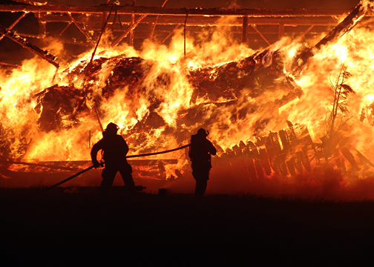
Procurement Integrity
Competition
Documentation
Specifications
Conflicts of Interest

Slide 101
Competition
Grantees are expected to promote competition. This means soliciting prices from multiple vendors and manufacturers.
Purchases should be made as a result of the competition—from the vendor or manufacturer who best meets the requirements and provides the grantee with the best price and quality.
The timeliness of delivery should be considered when making these decisions.

Slide 102
Documentation
Grantees are required to maintain documentation related to purchases.
Grantees who fail to document purchases may find that expenditures are disallowed.

Slide 103
Specifications
Specifications shall clearly describe the requirements of the product to be purchased or contracted.
However, specifications may not be written in a way that unnecessarily limits, restricts, or eliminates competition.

Slide 104
Specifications
Grantees cannot impose in-state or local geographical preferences in the evaluation of bids or proposals.
Grantees cannot use specifications obtained from vendors if they are found to be restrictive or proprietary.

Slide 105
Specifications
Do not indicate brand names in your application or in your specifications.
Grantees who specify brand name products may be asked to provide DHS with their procurement documents (such as requests for proposals, invitations for bids, or independent cost estimates).

Slide 106
Conflicts of Interest
Members of your department who work for vendors or manufacturers cannot:
    Work on the application
    Develop specifications
    Develop statements of work
    Participate in the procurement of any requested item in the grant

Slide 107
Conflicts May Exist
Those who may not benefit from the procurement of any item or contracted service purchased with grant funds include:
    Volunteers
    Officers
    Members
    Employees
    Family members
    Grant writers

Slide 108
Conflicts of Interest
Grantees who purchase items from vendors who employ any of their volunteers or members must document the procedures used to avoid a conflict of interest during the procurement process.

Slide 109
Procurement Integrity
For more information on procurement integrity refer to:
Code of Federal Regulations
CFR 44 Part 13.36
This information may be requested through the Government Printing Office or through an Internet search engine.

Slide 110
For Grant Assistance
Regional Points of Contact
Name: xxx-xxx-xxxx
Help Desk: 1-866-274-0960
E-mail: firegrants@dhs.gov
Web site: http://fema.gov/firegrants

Slide 111
Nine Stakeholder Organizations
If you would like to be considered as a panelist for one of our Peer Review Panels and are a member of one of the following stakeholder organizations, please contact your organization with your request, your resume or an outline of your background and experience in the fire service.
If you do not belong to one of these organizations send your information to one of us and we will forward it to the appropriate individual.

Slide 112
Nine Stakeholder Organizations
IAFC: International Association of Fire Chiefs
IAFF: International Association of Firefighters
NVFC: National Volunteer Fire Council
NFPA: National Fire Protection Association
NASFM: National Association of State Fire Marshals
IAAI: International Association of Arson Investigators
ISFSI: International Society of Fire Service Instructors
NAFTD: North American Fire Training Directors
CFSI: Congressional Fire Services Institute

Slide 113
Thank You

