Slide 1


Fuel Moisture and Wildland Fire Danger:
2012 Fire Season outlook
Jonathan Pangburn
CAL FIRE Unit Forester
San Benito-Monterey Unit
March 15, 2012
Notes:
This is a presentation to instruct Monterey County Fire Chiefs on fuel moisture and fire season outlook.

Slide 2
National Fuel Moisture Database
http://72.32.186.224/nfmd/public/states_map.php?state=CA
National database
  Query entries
  Google interface map for navigation
  Historic data & graphs

Slide 3
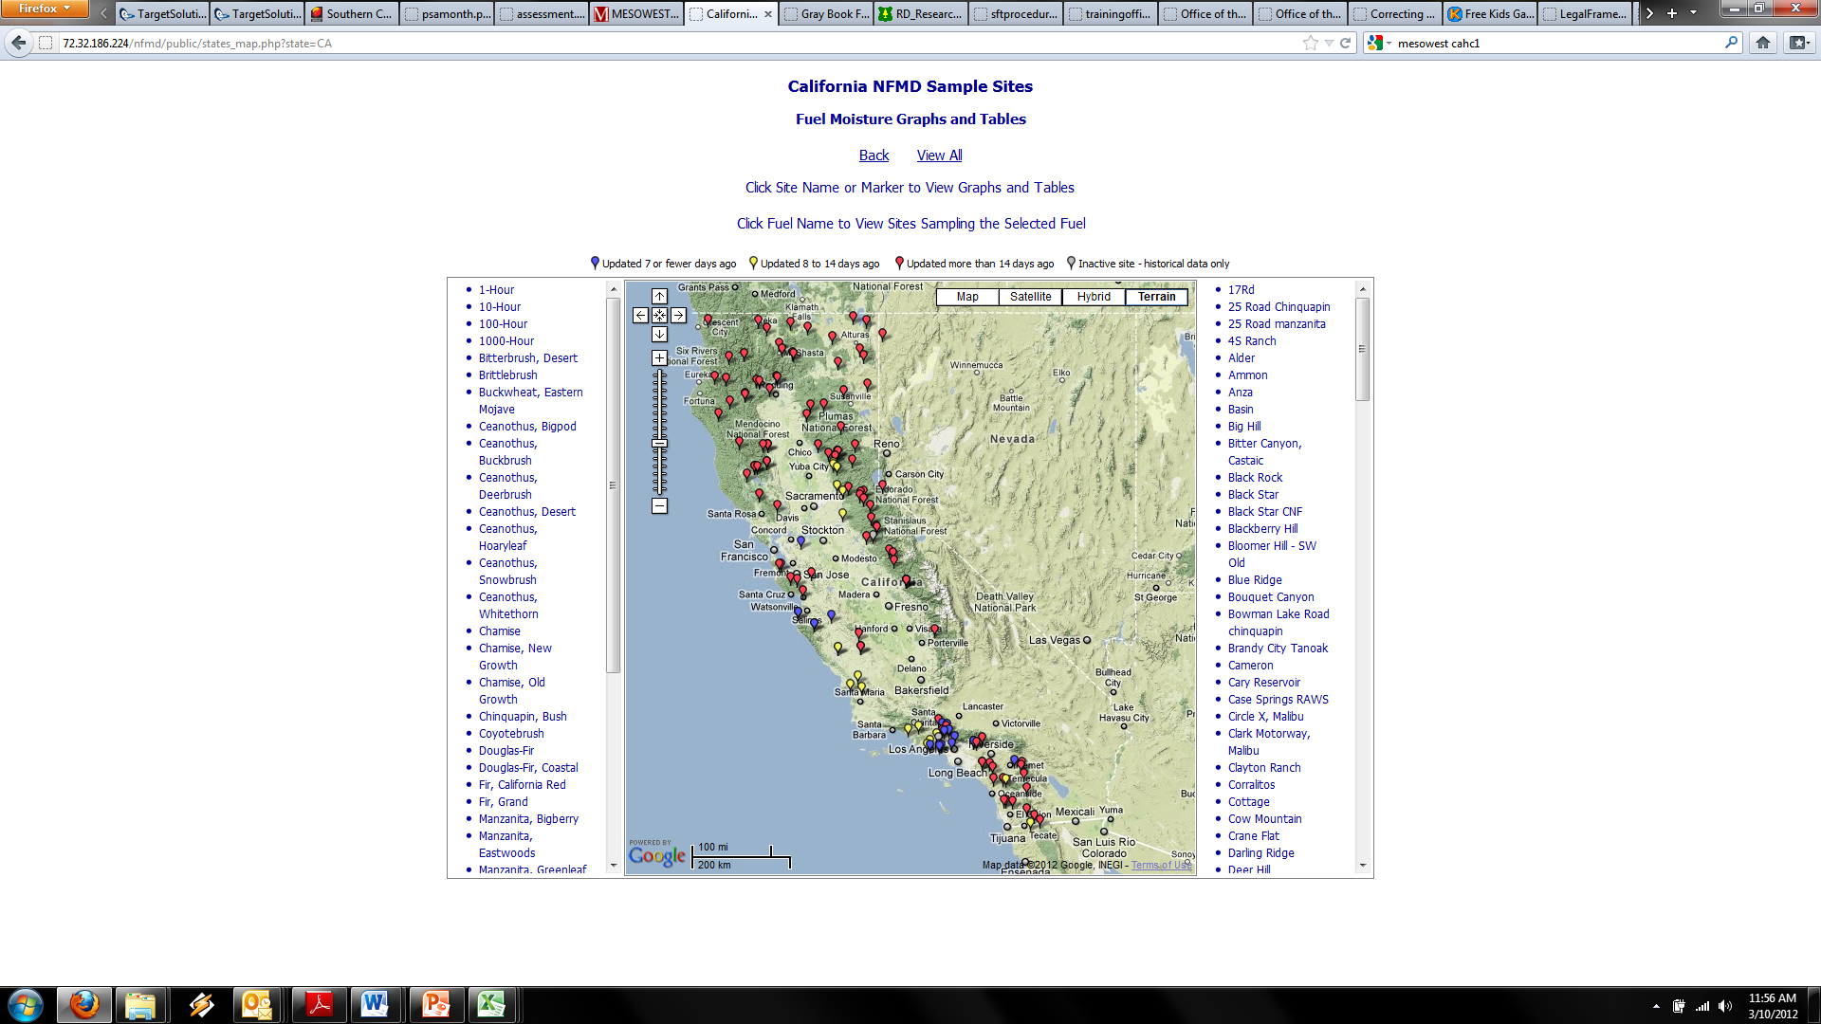
Notes:
On the National Fuel Moisture Database site, you can click on a state. This is what California looks like. You can query by map, collection site name, or fuels collected. You can change the map background (Google) by switching to hillshade or driving maps (or keep it on satellite imagery).

Slide 4
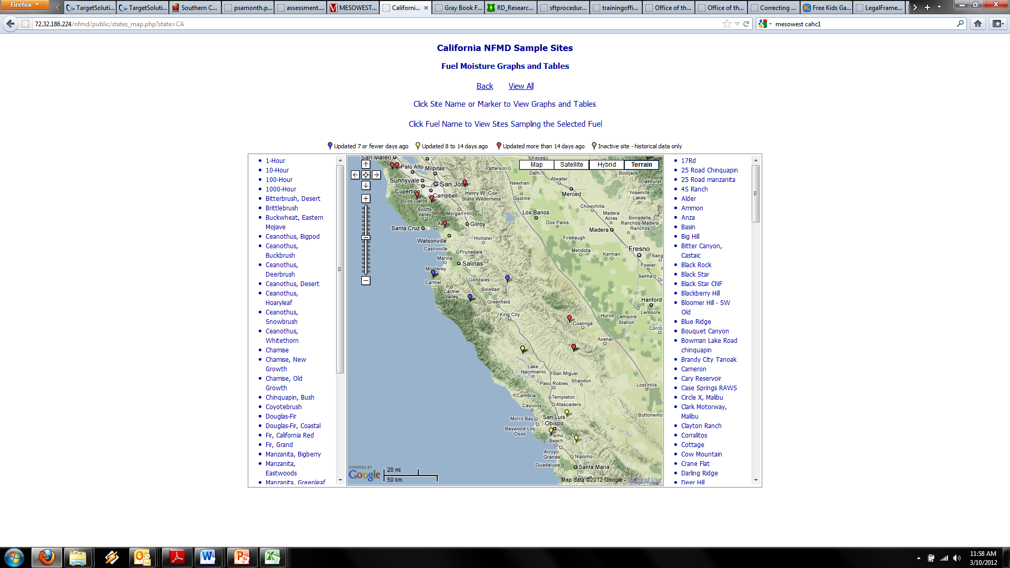
Notes:
This is a view of the 3 fuel moisture collection sites in BEU as of May 2011. Clicking on the points brings up the call out box (above for Smith Ranch, Battalion 6 – Bear Valley).

Slide 5
Southern CA GACC Fuels Info
http://gacc.nifc.gov/oscc/predictive/fuels_fire-danger/index.htm
Also check out link to Weather page:
  Links to RAWS/NWS historic data
  Webcast from meteorologist for forecast and fuels discussion

Slide 6
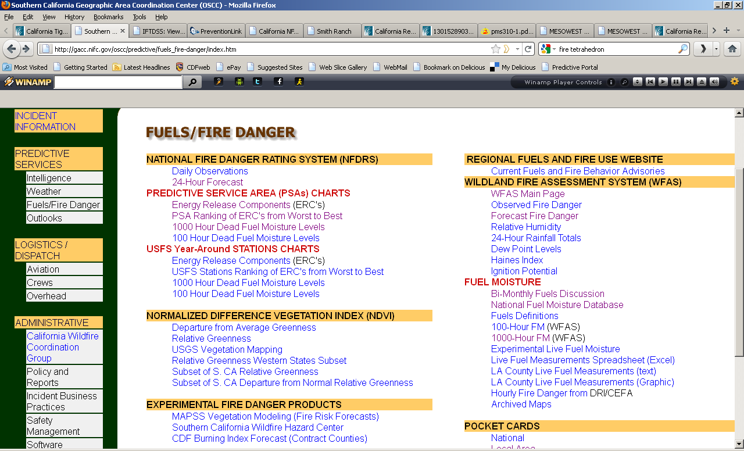
Notes:
This is a screen capture of the Predictive Services Fuels and Fire Danger website. If your location has an internet connection, please view this online and check out the links.

Slide 7
Local Fuel Moisture Data - 2011
Notes:
This is a graph of chamise fuel moisture in the San Benito-Monterey Unit. It shows historic average for old growth and new growth, as well as site-specific data.

Slide 8
Local Fuel Moisture Data - 2012
Notes:
This is a graph of chamise fuel moisture in the San Benito-Monterey Unit. It shows historic average for old growth and new growth, as well as site-specific data.

Slide 9
Local Fuel Moisture Data, cont.
Location | Elevation | 1-hour | 10-hour | Species | Fuel Moisture
Data available online at the National Fuel Moisture Database (click for link) |  |  |  |  | Current | Previous | Change | 2011
Battalion 1 Hastings | 1,800 | 5% | 6% | Chamise Old | 74% | 67% | + 7 | 84%
 |  |  |  | Chamise New | -- | -- | -- | N/A
 |  |  |  | Ceanothus Old | 90% | 81% | + 9 | 112%
 |  |  |  | Ceanothus New | -- | -- | -- | N/A
Battalion 2 Pebble Beach | 350 | 9% | 10% | Manzanita Old | 84% | 85% | - 1 | N/A
 |  |  |  | Manzanita New | -- | -- | -- | N/A
Battalion 4 Lockwood Stn. | 2,800 | 3% | 4% | Chamise Old | 65% | 69% | - 4 | N/A
 |  |  |  | Chamise New | -- | -- | -- | N/A
 |  |  |  | Manzanita Old | 81% | 88% | - 1 | N/A
 |  |  |  | Manzanita New | -- | -- | -- | N/A
Battalion 4 Parkfield Stn. | 2,200 | -- | -- | Chamise Old | -- | -- | -- | N/A
 |  |  |  | Chamise New | -- | -- | -- | N/A
 |  |  |  | Ceanothus Old | -- | -- | -- | N/A
 |  |  |  | Ceanothus New | -- | -- | -- | N/A
Battalion 6 Bear Valley Stn. | 1,400 | 3% | 4% | Chamise Old | 89% | 69% | + 20 | 92%
 |  |  |  | Chamise New | -- | -- | -- | --
The recent precipitation has led to a slight increase for fuel moisture in the unit. New growth is almost non-existent; where present, it’s on less than 25% of plants and less than 1/4 inch. The weather forecast calls for continued drought conditions overall, although there is a chance of precipitation this week.
LFM is calculated by the formula (Live Sample Weight-Dry Sample Weight)/Dry Sample Weight
60% = critical LFM for chamise |  |  |  | 80% = critical LFM for manzanita
100% = critical LFM for conifers |  |  |  | 100% = critical LFM for sagebrush
Notes:
This is an example table of fuel moisture data for San Benito-Monterey Unit from May 5, 2011.

Slide 10
Local Precipitation Data
Notes:
Precipitation is extremely low this year at our RAWS stations: 24%-37% of normal

Slide 11
Local Precipitation Data, cont.

Slide 12
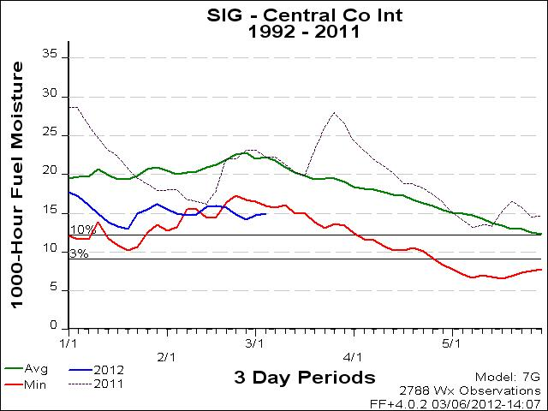
GACC Fuel Moisture Data

Slide 13
GACC Fuel Moisture Data
1,000 Hour Fuel Moisture is the lowest reading on record (new minimum right now)

Slide 14
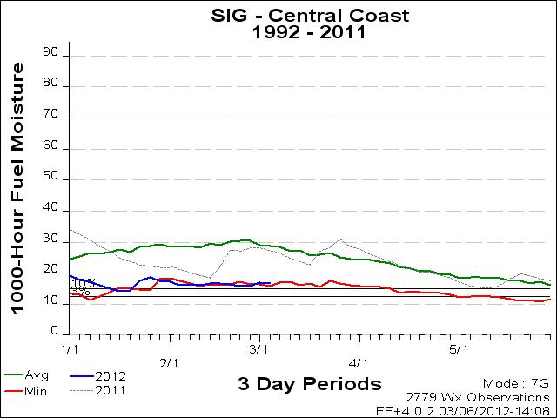
GACC Fuel Moisture Data, cont.

Slide 15
GACC Fuel Moisture Data, cont.
1,000 Hour Fuel Moisture is near new minimum right now

Slide 16
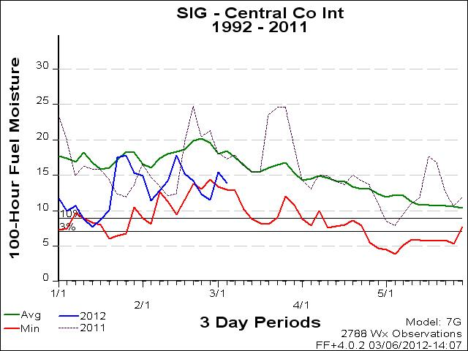
GACC Fuel Moisture Data, cont.

Slide 17
GACC Fuel Moisture Data, cont.
100 Hour Fuel Moisture is near minimum, well below average

Slide 18
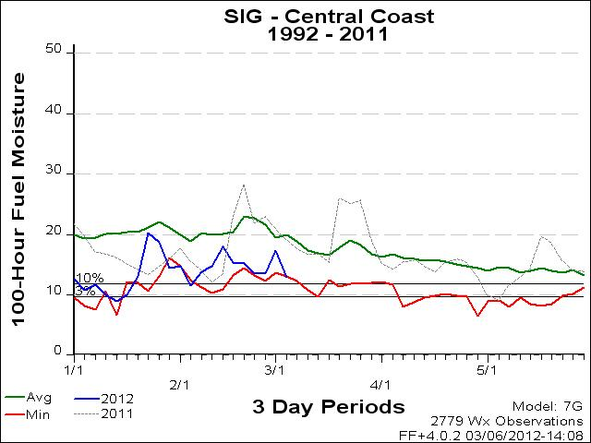
GACC Fuel Moisture Data, cont.

Slide 19
GACC Fuel Moisture Data, cont.
100 Hour Fuel Moisture is at a new minimum

Slide 20
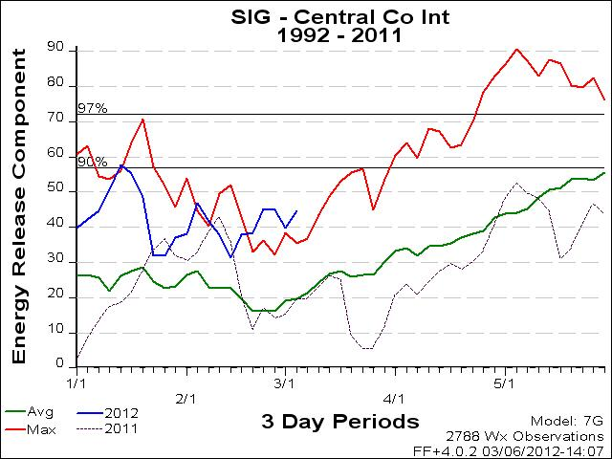
Energy Release Component, cont.

Slide 21
Energy Release Component, cont.
ERC at new maximum right now

Slide 22
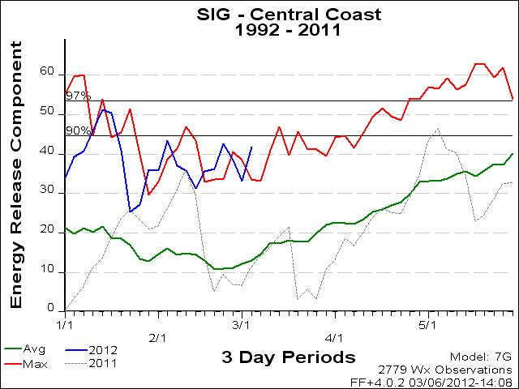
Energy Release Component, cont.

Slide 23
Energy Release Component, cont.
ERC at new maximum right now

Slide 24
Region Monthly Outlook
Outlook for March:
  Below normal precipitation for region
  Near normal temperatures central CA to above normal in southern CA
  Near normal large fire potential
  Weather conditions turning drier and warmer toward the end of the month
http://gacc.nifc.gov/oscc/predictive/outlooks/myfiles/psamonth.pdf

Slide 25
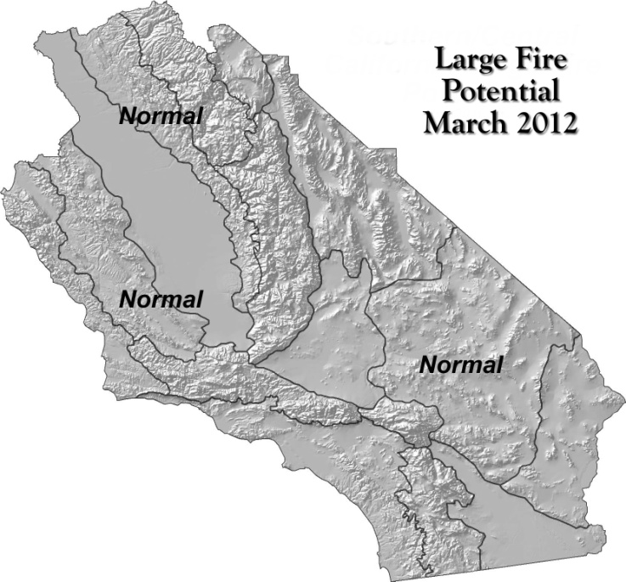
Region Monthly Outlook

Slide 26
Region Seasonal Outlook
Outlook for March-June:
  Below normal precipitation over the entire region
  Above normal temperatures
  Drought developing and expanding over the region by spring
  Above normal potential in most of the mountain areas as well as inland valley and foothill regions away from the coast
http://gacc.nifc.gov/oscc/predictive/outlooks/myfiles/assessment.pdf

Slide 27
Region Seasonal Outlook, cont.
Outlook for March-June:
  La Niña weakening, ending altogether by spring
  Continuation of below average precipitation will likely continue this spring
  Very little additional rainfall can be expected through the springtime months, especially over Southern CA
  2011-2012 will undoubtedly finish will far below normal rainfall over nearly the entire region
http://gacc.nifc.gov/oscc/predictive/outlooks/myfiles/assessment.pdf

Slide 28
Region Seasonal Outlook, cont.
Outlook for March-June:
  Above normal large fire potential for many inland and mountainous regions, especially in May and June
  Uncertainty if monsoon season will bring any relief to expected dry conditions
http://gacc.nifc.gov/oscc/predictive/outlooks/myfiles/assessment.pdf

Slide 29
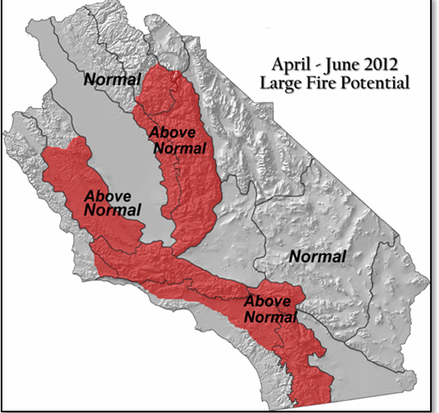
Region Seasonal Outlook

Slide 30
Region Fuels Discussion
Fuel dryness is expected to accelerate rapidly this spring as daylight hours become longer and the solar angle becomes higher
Seasonal grasses, which only saw limited greenup this year, will be fully cured by early to mid April
Heavier fuels and live fuels will likely become dry enough in May to support fire during windy periods

Slide 31
Region Fuels Discussion, cont.
Higher elevations: lack of snowpack may allow mature timber stands to carry fire this summer
Drought conditions are already being experienced over portions of the state
Much of central and southern CA (including BEU) is in a D1, or moderate, drought status
Late spring to summer, expect this area to intensify and expand over much of the state
Lack of winter runoff will prevent reservoir storage from gaining volume

Slide 32
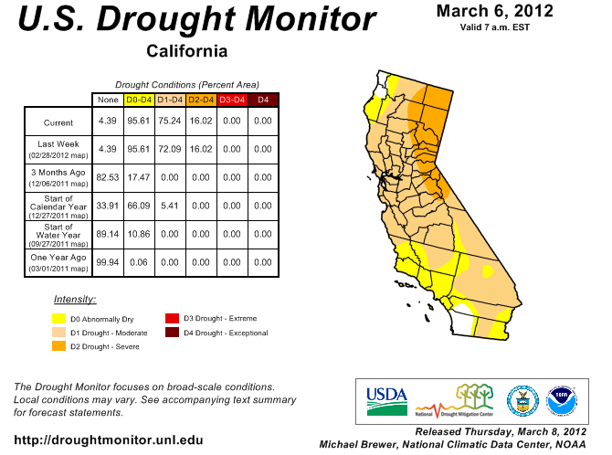
Drought Map

